Slide 1





Intro to Spark Development
June 2015: Spark Summit West / San Francisco
http://training.databricks.com/intro.pdf
https://www.linkedin.com/in/bclapper
Notes:
Greet students and mention:
I’d like to start by mentioning that this slide deck is being released under a Creative Commons license which allows everyone to download and share this deck as long as you don’t use it commercially.
This talk will shortly be on YouTube, so don’t worry about taking notes
Mention WIFI details: ???
So, today, I’d like to bootstrap you on your journey of learning and using Spark. By the end of today, you will be familiar with Spark’s architecture and programming API and will have written simple Spark applications.
“When you first look at Spark, it can be somewhat intimidating. One primary goal for today is to demystify Spark, so you can step into using it with confidence.”

Slide 2

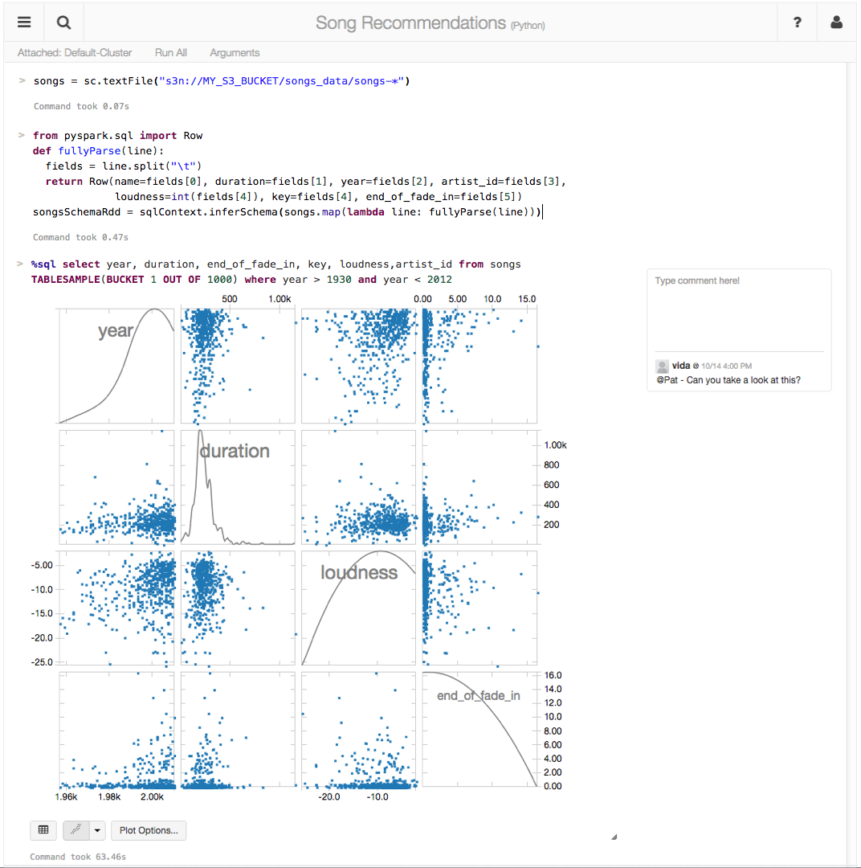
making big data simple
Founded in late 2013
by the creators of Apache Spark
Original team from UC Berkeley AMPLab
Raised $47 Million in 2 rounds
~55 employees
We’re hiring!
Level 2/3 support partnerships with
Hortonworks
MapR
DataStax
(http://databricks.workable.com)
Databricks Cloud:
“A unified platform for building Big Data pipelines – from ETL to Exploration and Dashboards, to Advanced Analytics and Data Products.”
Notes:
Databricks is a company that was founded by the creators of the Spark project in 2013.
And one of the first things the founders did after starting the company was donating Spark to the Apache Software Foundation and they remain the largest contributor to Spark’s code base.
Databricks Cloud is a end-to-end hosted service. The goal of our product is to be the easiest place to be up and running with Spark with little or no up-front hardware or cost investment, since it’s a cloud service. We want to help our customers quickly pull out insights via visualization from your data… without worrying about the intricacies of installing and configuring a large Hadoop cluster.

Slide 3
The Databricks team contributed more than 75% of the code added to Spark in the past year

Slide 4

Agenda
Before Lunch
After Lunch
History of Big Data & Spark
RDD fundamentals
Databricks UI demo
Lab: DevOps 101
Transformations & Actions
Transformations & Actions (continued)
Lab: Transformations & Actions
Dataframes
Lab: Dataframes
Spark UIs
Resource Managers: Local & Stanalone
Memory and Persistence
Spark Streaming
Lab: MISC labs
Notes:
UPDATE
This will be a fast-paced, very technical and vendor agnostic class on Spark

Slide 5
Some slides will be skipped
Please keep Q&A low during class
(5pm – 5:30pm for Q&A with instructor)
2 anonymous surveys: Pre and Post class
Lunch: noon – 1pm
2 breaks (sometime before lunch and after lunch)

Slide 6

Instructor: Brian Clapper
Homepage: http://www.ardentex.com/
LinkedIn: https://www.linkedin.com/in/bclapper
@brianclapper
30 years experience building & maintaining software systems
Scala, Python, Ruby, Java, C, C#
Founder of Philadelphia area Scala user group (PHASE)
Spark instructor for Databricks
Notes:
Mention that you’ve taught classes on Python, Ruby, Scala and Java

Slide 7
Survey completed by 58 out of 115 students
Your job?
Notes:
Developer: 42 people
Data Scientists: 15 people

Slide 8
Traveled from?
Survey completed by 58 out of 115 students

Slide 9
Survey completed by 58 out of 115 students
Which Industry?
Notes:
IT: 26 people
Banking: 8 people

Slide 10
Survey completed by 58 out of 115 students
Prior Spark training?
Notes:
52 people have not attended any previous training

Slide 11
Survey completed by 58 out of 115 students
Hands on Experience with Spark?

Slide 12
Survey completed by 58 out of 115 students
Spark usage lifecycle?

Slide 13
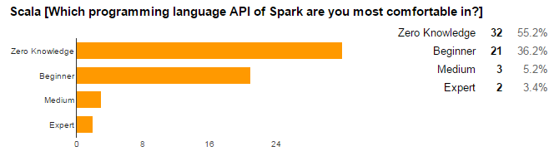
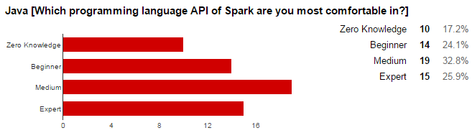
Survey completed by 58 out of 115 students
Programming Experience

Slide 14
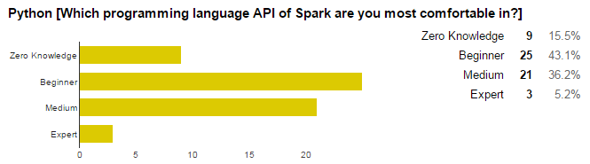
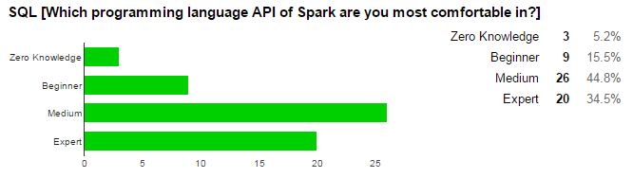
Survey completed by 58 out of 115 students
Programming Experience

Slide 15
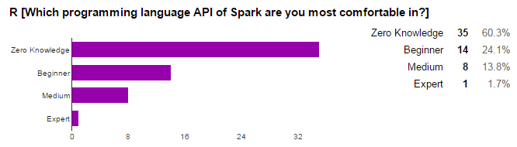
Survey completed by 58 out of 115 students
Programming Experience

Slide 16
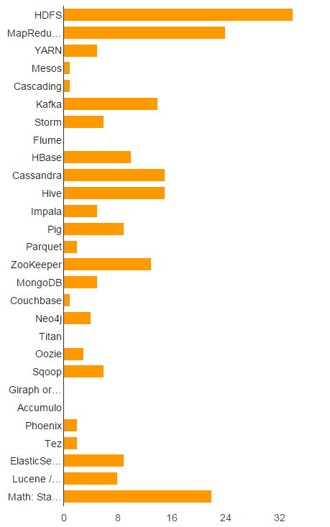
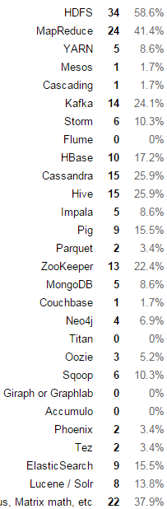
Survey completed by 58 out of 115 students
Big Data Experience
Notes:
HDFS: 34 people or 58% of audience
MapReduce: 24 people or 42% of audience

Slide 17
Survey completed by 58 out of 115 students
Focus of class?
Notes:
50 people or 86% would like us to focus on Development today

Slide 18
Storage vs Processing wars
NoSQL battles
Compute battles
(then)
(now)
MapReduce vs Spark
Relational vs NoSQL
HBase vs Cassanrdra
Spark Streaming vs Storm
Redis vs Memcached vs Riak
Hive vs Spark SQL vs Impala
MongoDB vs CouchDB vs Couchbase
Mahout vs MLlib vs H20
Neo4j vs Titan vs Giraph vs OrientDB
Solr vs Elasticsearch
Notes:
http://db-engines.com/en/
One way to think about the era of Big Data is as the Storage buildout era and the Compute buildout era.
From 2008 – 2013, it was primarily about figuring out whether this NoSQL thing was just hype or if there was something worthwhile to it. The general consensus seems to be that for certain use cases involving very large scale or specialized queries, it does make sense to break out of the relational model and store data in specialized databases.
But after moving 10TB of data from Oracle to Cassandra, what do you do with it next? Applying the same point queries and select statements from the relational era doesn’t fulfil the ambitions of the big data promise.
What we were lacking 5 years ago is specialized processing engines to compliment our NoSQL stores. But specialized processing systems came at a high cognitive overload cost. Now, big data engineers didn’t just have to understand a handful of NoSQL architectures, but also a handful of processing architectures. This was too much effort…
Enter Spark.

Slide 19
Storage vs Processing wars
NoSQL battles
Compute battles
(then)
(now)
MapReduce vs Spark
Relational vs NoSQL
HBase vs Cassanrdra
Spark Streaming vs Storm
Redis vs Memcached vs Riak
Hive vs Spark SQL vs Impala
MongoDB vs CouchDB vs Couchbase
Mahout vs MLlib vs H20
Neo4j vs Titan vs Giraph vs OrientDB
Solr vs Elasticsearch
Notes:
http://db-engines.com/en/

Slide 20

NOSQL Popularity WInners
Key -> Value
Key -> Doc
Column Family
Graph
Search
Redis - 95
Memcached - 33
DynamoDB - 16
Riak - 13
MongoDB - 279
CouchDB - 28
Couchbase - 24
DynamoDB – 15
MarkLogic - 11
Cassandra - 109
HBase - 62
Neo4j - 30
OrientDB - 4
Titan – 3
Giraph - 1
Solr - 81
Elasticsearch - 70
Splunk – 41
Notes:
http://db-engines.com/en/
The DB-Engines Ranking does not measure the number of installations of the systems, or their use within IT systems.
DB Popularity uses:
# of mentions of the systems on websites
Google Trends
Frequency of technical discussions on Strack Overflow and DBA StackExchange
# of job listings on indeed.com and SImplyHired
# of profiles mentioning the technology on LInkedIN
Tweets.

Slide 21

(2007 – 2015?)
Giraph
Pregel
(2014 – ?)
(2004 – 2013)
Tez
Drill
Dremel
Mahout
Storm
S4
Impala
GraphLab
Specialized Systems
General Batch Processing
(iterative, interactive, ML, streaming, graph, SQL, etc)
General Unified Engine
Notes:
Mention that first there was a general batch system for all big data processing (MapReduce)
Then recently came the short period of specialized systems, but they were quite complicated and different from each other to learn
Spark is trying to unify the most popular processing paradigms
Mention that now 2 engineers who know the Spark API can do what used to take a team of 10 engineers

Slide 22



Scheduling
Monitoring
Distributing
Notes:
Spark:
Schedules computational tasks to run in a cluster
Let’s you monitor the progress of your big data application
Lets you distribute computational tasks across the cluster

Slide 23






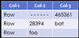
















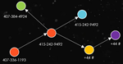






RDBMS
SQL
Distributions:
CDH
HDP
MapR
DSE
Tachyon
Streaming
Hadoop Input Format
DataFrames API
GraphX
MLlib
Apps
Notes:
SparkR was introduced just a few days ago with Spark 1.4. This is Spark’s first new language API since PySpark was added in 2012. SparkR is based on Spark’s parallel DataFrame abstraction. Users can create SparkR DataFrames from “local” R data frames, or from any Spark data source such as Hive, HDFS, Parquet or JSON. SparkR DataFrames support all Spark DataFrame operations including aggregation, filtering, grouping, summary statistics, and other analytical functions. They also supports mixing-in SQL queries, and converting query results to and from DataFrames. Because SparkR uses the Spark’s parallel engine underneath, operations take advantage of multiple cores or multiple machines, and can scale to data sizes much larger than standalone R programs.
The new DataFrames API was inspired by data frames in R and Pandas in Python. DataFrames integrate with Python, Java, Scala and R and give you state of the art optimization through the Spark SQL Catalyst optimizer. DataFrames are just a distributed collection of data organized into named columns and can be made from tables in Hive, external databases or existing RDDs.
SQL: Spark’s module for working with structured data made of rows and columns. Spark SQL used to work against a special type of RDD called a SchemaRDD, but that is now being replaced with DataFrames. Spark SQL reuses the Hive frontend and metastore, which gives you full compatibility with existing Hive data, queries and UDFs. This allows you to run unmodified Hive queries on existing data warehouses. There is also standard connectivity through JDBC or ODBC via a Simba driver. Tableau uses this Simba driver to send queries down to Spark SQL to run at scale.
Streaming: makes it easy to build scalable fault-tolerant streaming applications with stateful exactly-once symantics out of the box. Streaming allows you to reuse the same code for batch processing and stream processing. In 2012, Spark Streaming was able to process over 60 million records per second on 100 nodes at sub-second processing latency, which makes it 2 – 4x faster than comparable systems like Apache Storm on Yahoo’s S4. Netflix is one of the big users of Spark Streaming. (60 million / 100 = 600k)
Spark Streaming is able to process 100,000-500,000 records/node/sec. This is much faster than Storm and comparable to other Stream processing systems. Sigmoid was able to consume 480,000 records per second per node machines using Kafka as a source.
Kafka: Kafka basically acts as a buffer for incoming data. It is a high-throughput distributed messaging system. So Kafka maintains feeds of messages in categories called topics that get pushed or published into Kafka by producers. Then consumers like Spark Streaming can subscribe to topics and consume the feed of published messages. Each node in a Kafka cluster is called a broker. More than 75% of the time we see Kafka being used instead of Flume.
Flume: Distributed log collection and aggregation service for moving large amounts of log data from many different sources to a centralized data store. So with Flume, data from external sources like web servers is consumed by a Flume source. When a Flume source receives an event, it stores it into one or more channels. The channels will keep the event until its consumed by a Flume sink. So, when Flume pushes the data into the sink, that’s where the data is buffered until Spark Streaming pulls the data from the sink.
MLlib + GraphX: Mllib is Spark’s scalable machine learning library consisting of common algorithms and utilities including classification, regression, clustering, collaborative filtering, dimensionality reduction. MLlib’s datatypes are vectors and matrices and some of the underlying linear algebra operations on them are provided by Breeze and jblas. The major algorithmic components in Mllib are statistics (like max, min, mean, variance, # of non-zeroes, correlations (Pearson’s and Spearman’s correlations), Stratified Sampling, Hypothesis testing, Random Data Generation, Classification & Regression (like linear models, SVMs, logistic regression, linear regression, naïve Bayes, decision trees, random forests, gradient-boosted trees), Collaborative filtering (ALS), Clustering (K-means), Dimensionality reduction (Singular value decomposition/SVD and Principal Component Analysis/PCA), Feature extraction and transformation, optimization (like stochastic gradient descent and limited memory BFGS).
Tachyon: memory based distributed storage system that allows data sharing across cluster frameworks like Spark or Hadoop MapReduce. Project has 60 contributors from 20 institutions. Has a Java-like API similar to that of java.io.File class providing InputStream and OutputStream interfaces. Tachyon also implements the Hadoop FileSystem interface, to allow frameworks that can read from Hadoop Input Formats like MapReduce or Spark to read the data. Tachyon has some interesting features for data in tables… like native support for multi-columned data with the option to put only hot columns in memory to save space.
BlinkDB: is an approximate query engine for running interactive SQL queries on large volumes of data. It allows users to trade off query accuracy for response time by running queries on data samples and presenting results annotated with error bars. BlinkDB was demoed in 2012 on a 100 node Amazon EC2 cluster answering a range of queries on 17 TBs of data in less than 2 seconds (which is over 200x faster than Hive) with an error of 2 – 10%. To do this, BlinkDB uses an offline sampling module that creates uniform and stratified samples from underlying data. Two of the big users of BlinkDB are Conviva and Facebook.

Slide 24
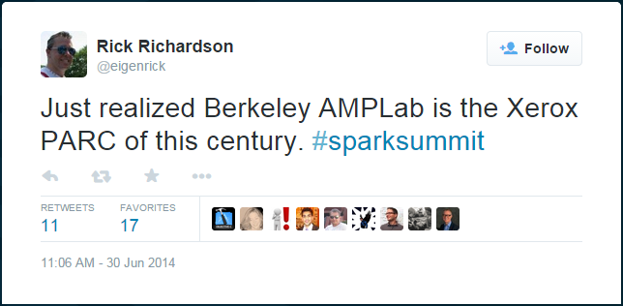

Slide 25
Developers from 50+ companies
400+ developers
Apache Committers from 16+ organizations

Slide 26




vs
YARN
Mesos
Tachyon
SQL
MLlib
Streaming
Notes:
YARN: is a resource manager
The cool thing about Spark is that it has a unified API for SQL, ML, and Streaming.

Slide 27



10x – 100x

Slide 28
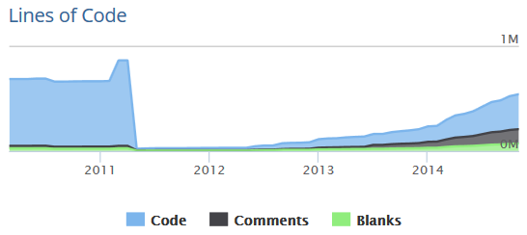
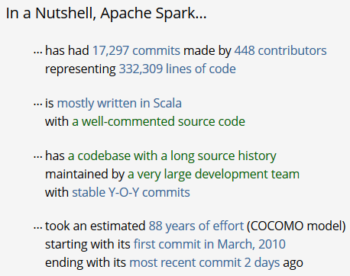
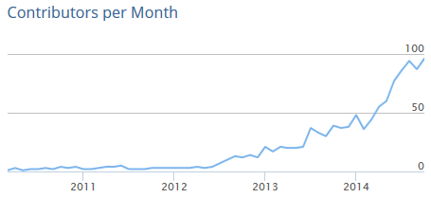
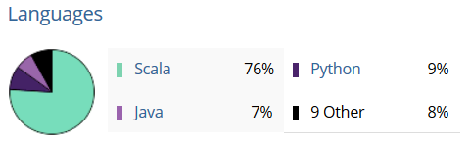

Aug 2009
...in June 2013
Source: openhub.net
Notes:
First open sourced around 2010.
Currently there’s 700+ total contributors to Spark and 400K lines of code, and 500+ active production deployments.
Spark is:
The most active Apache project in contributors per month
The most active open source project in a functional language
- 700+ contributors, 400,00+ lines of code (most of the new code is the libraries, not the core)

Slide 29



































Distributors
Applications

Slide 30

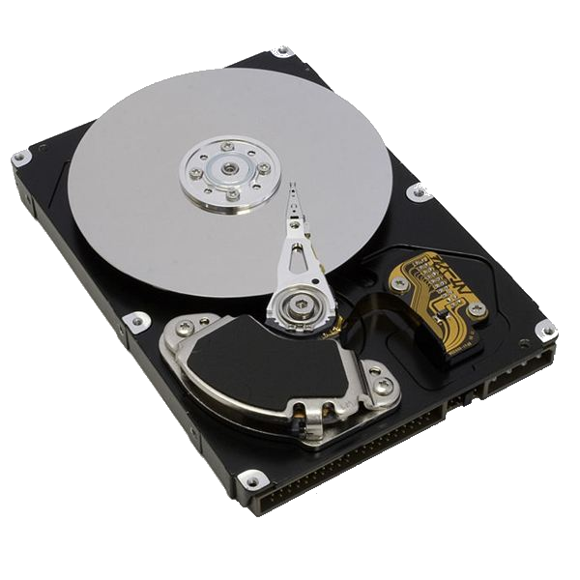

0.1 Gb/s
1 Gb/s or 125 MB/s
Nodes in another rack
CPUs:
Network
10 GB/s
1 Gb/s or 125 MB/s
Nodes in same rack
100 MB/s
600 MB/s
3-12 ms random access
$0.05 per GB
0.1 ms random access
$0.45 per GB

Slide 31
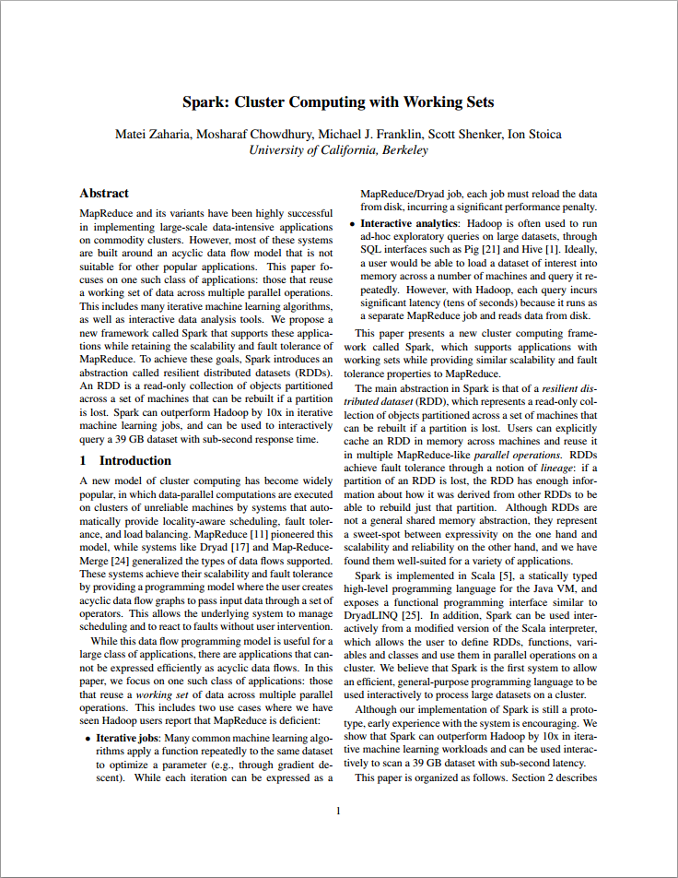
“The main abstraction in Spark is that of a resilient dis-
tributed dataset (RDD), which represents a read-only collection of objects partitioned across a set of machines that can be rebuilt if a partition is lost.
Users can explicitly cache an RDD in memory across machines and reuse it in multiple MapReduce-like parallel operations.
RDDs achieve fault tolerance through a notion of lineage: if a partition of an RDD is lost, the RDD has enough information about how it was derived from other RDDs to be able to rebuild just that partition.”
June 2010
http://www.cs.berkeley.edu/~matei/papers/2010/hotcloud_spark.pdf
Notes:
Paper is 6 pages

Slide 32
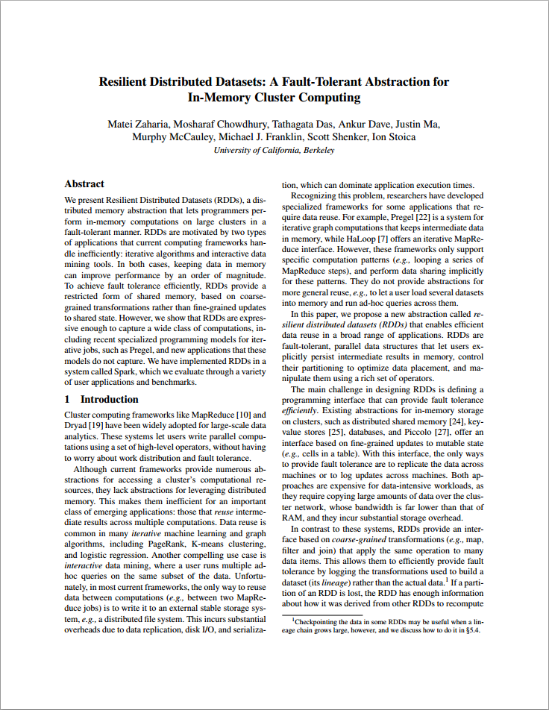
“We present Resilient Distributed Datasets (RDDs), a distributed memory abstraction that lets programmers perform in-memory computations on large clusters in a fault-tolerant manner.
RDDs are motivated by two types of applications that current computing frameworks handle inefficiently: iterative algorithms and interactive data mining tools.
In both cases, keeping data in memory can improve performance by an order of magnitude.”
“Best Paper Award and Honorable Mention for Community Award”
- NSDI 2012
- Cited 400+ times!
April 2012
http://www.cs.berkeley.edu/~matei/papers/2012/nsdi_spark.pdf
Notes:
Paper is 13 pages

Slide 33
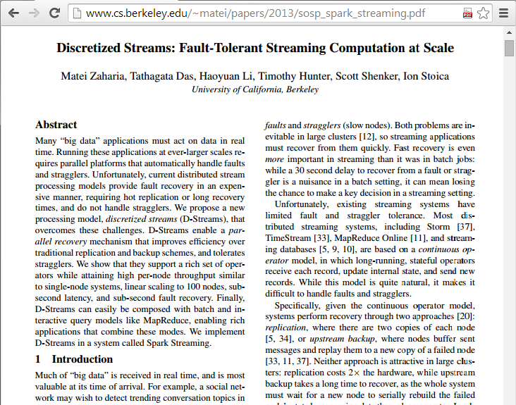
Streaming
Analyze real time streams of data in ½ second intervals
TwitterUtils.createStream(...) .filter(_.getText.contains("Spark")) .countByWindow(Seconds(5))
- 2 Streaming Paper(s) have been cited 138 times

Slide 34
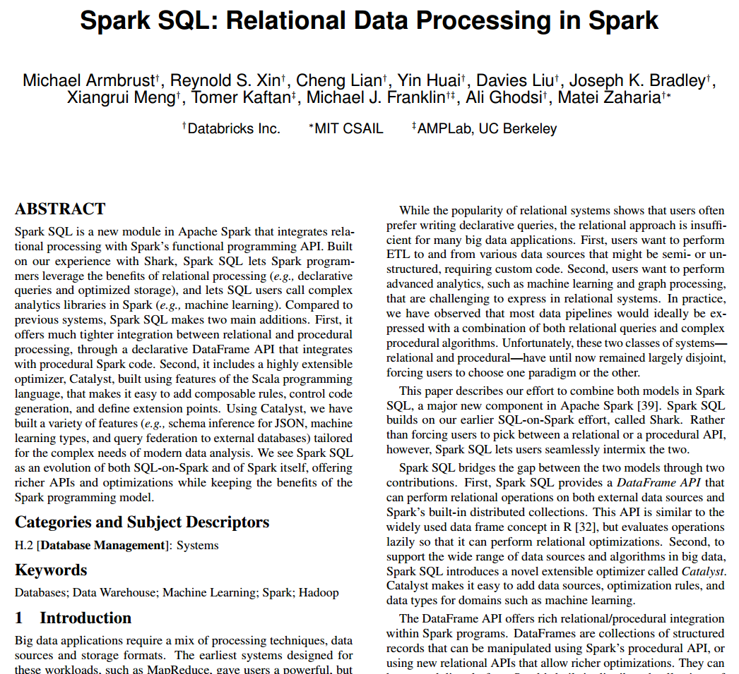
SQL
Seemlessly mix SQL queries with Spark programs.
sqlCtx = new HiveContext(sc)
results = sqlCtx.sql(
"SELECT * FROM people")
names = results.map(lambda p: p.name)
Notes:
In the code: Apply functions to results of SQL queries.
Run unmodified Hive queries on existing warehouses.
Connect through JDBC or ODBC.
Special Interest Group for Management of Data
This was an invited paper for the Industrial track to be held in Melbourne, Australia in early June 2015

Slide 35
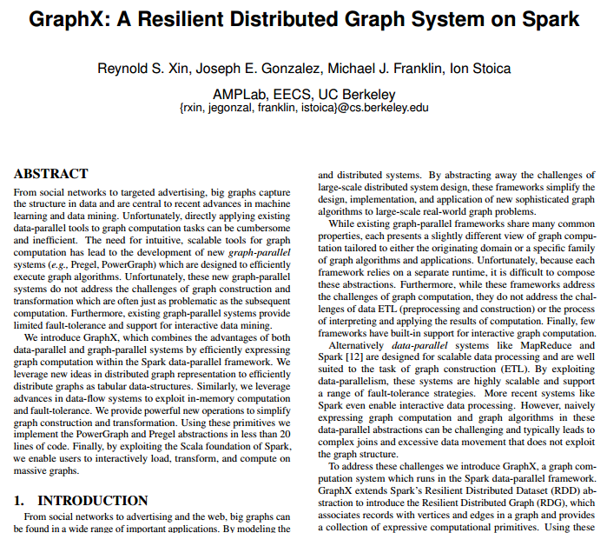
GraphX
Analyze networks of nodes and edges using graph processing
graph = Graph(vertices, edges) messages = spark.textFile("hdfs://...") graph2 = graph.joinVertices(messages) { (id, vertex, msg) => ... }
https://amplab.cs.berkeley.edu/wp-content/uploads/2013/05/grades-graphx_with_fonts.pdf
Notes:
GraphX unifies ETL, exploratory analysis, and iterative graph computation within a single system. You can view the same data as both graphs and collections, transform and join graphs with RDDs efficiently, and write custom iterative graph algorithms using the Pregel API.

Slide 36

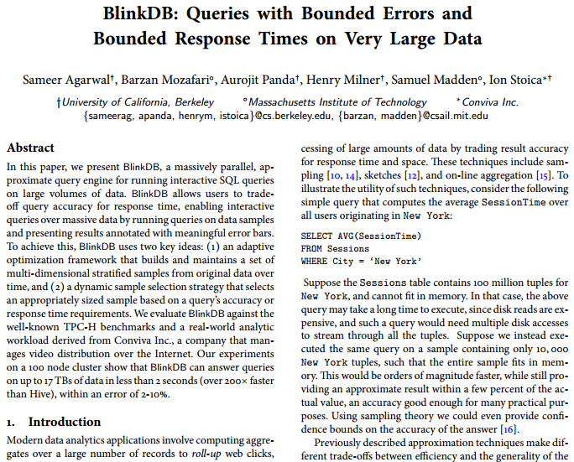
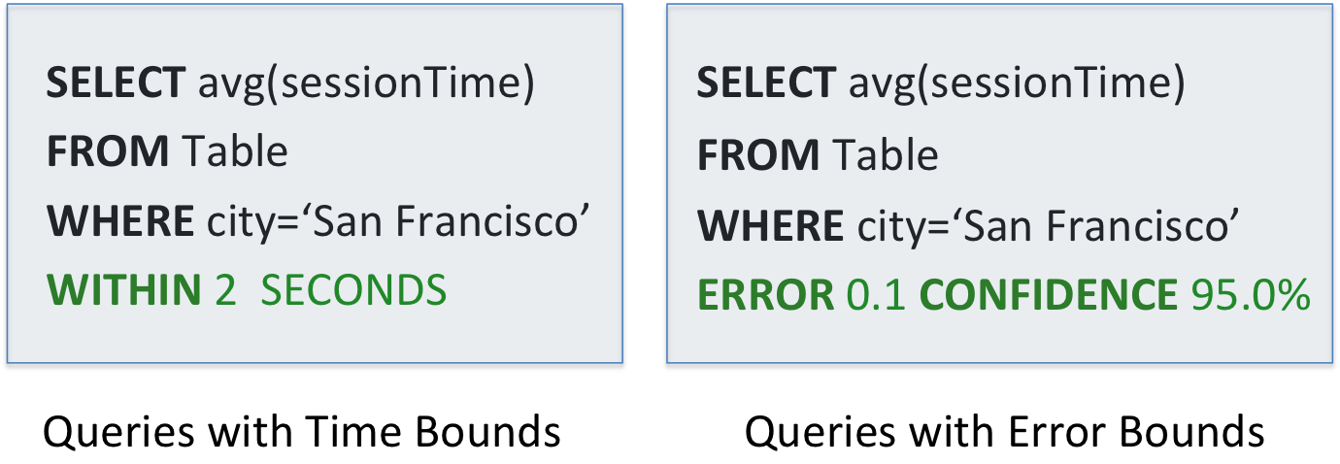
SQL queries with Bounded Errors and Bounded Response Times
https://www.cs.berkeley.edu/~sameerag/blinkdb_eurosys13.pdf
Notes:
BlinkDB: is an approximate query engine for running interactive SQL queries on large volumes of data. It allows users to trade off query accuracy for response time by running queries on data samples and presenting results annotated with error bars. BlinkDB was demoed in 2012 on a 100 node Amazon EC2 cluster answering a range of queries on 17 TBs of data in less than 2 seconds (which is over 200x faster than Hive) with an error of 2 – 10%. To do this, BlinkDB uses an offline sampling module that creates uniform and stratified samples from underlying data. Two of the big users of BlinkDB are Conviva and Facebook.

Slide 37
Estimate
true answer
How do you know when to stop?
# of data points
Notes:
State of the art Machine Learning algorithms don’t scale easily b/c it is prohibitive to process all the data points.
SO, how do you know when you can stop processing more data b/c you are close enough to the final answer?

Slide 38
Estimate
true answer
Error bars on every answer!
# of data points
Notes:
State of the art Machine Learning algorithms don’t scale easily b/c it is prohibitive to process all the data points.
SO, how do you know when you can stop processing more data b/c you are close enough to the final answer?

Slide 39
Estimate
true answer
Stop when error smaller than a given threshold
# of data points
time

Slide 40
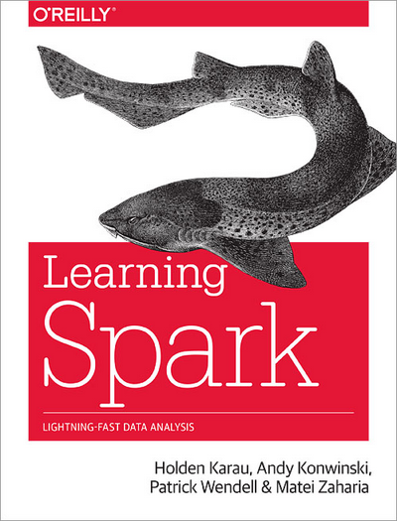
http://shop.oreilly.com/product/0636920028512.do
eBook: $33.99
Print: $39.99
PDF, ePub, Mobi, DAISY
Shipping now!
$30 @ Amazon:
http://www.amazon.com/Learning-Spark-Lightning-Fast-Data-Analysis/dp/1449358624
Notes:
Book has 4 out of 5 stars between 25 reviews at Amazon.com and O’Reilly as of March 2015.

Slide 41
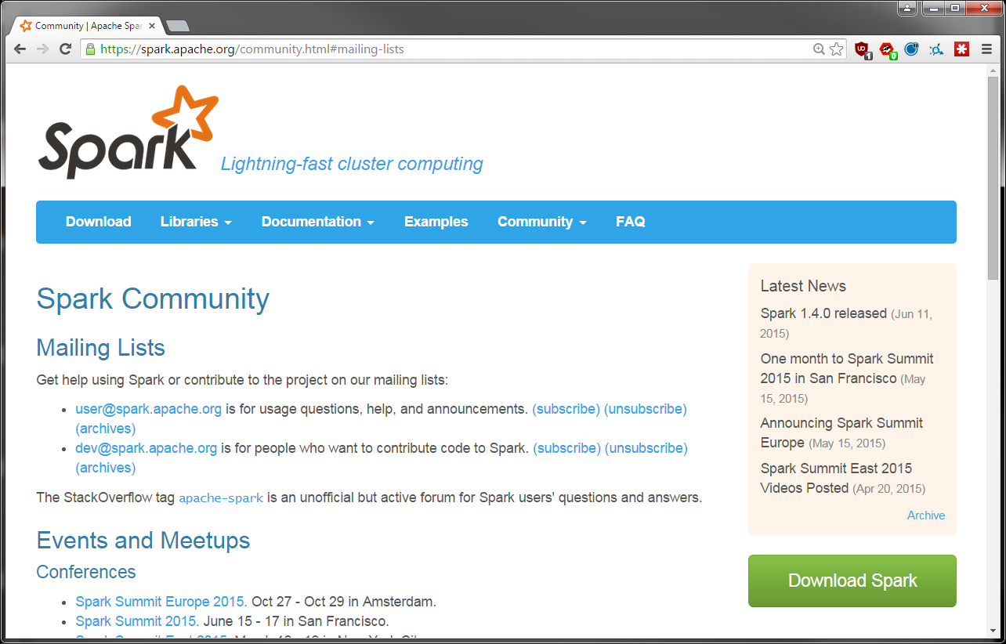

Slide 42
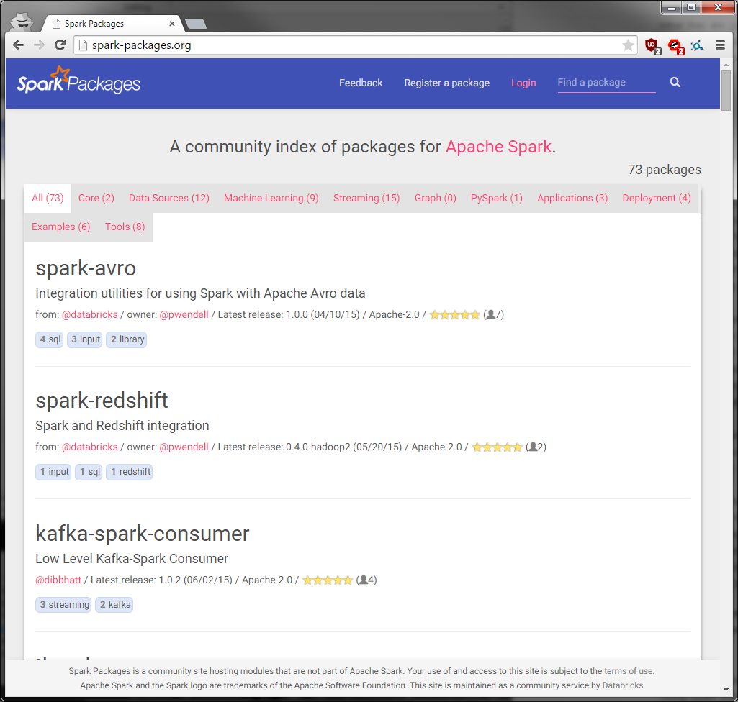

Notes:
Today, we are happy to announce Spark Packages (http://spark-packages.org), a community package index to track the growing number of open source packages and libraries that work with Apache Spark. Spark Packages makes it easy for users to find, discuss, rate, and install packages for any version of Spark, and makes it easy for developers to contribute packages.
Spark Packages will feature integrations with various data sources, management tools, higher level domain-specific libraries, machine learning algorithms, code samples, and other Spark content. Thanks to the package authors, the initial listing of packages includes scientific computing libraries, a job execution server, a connector for importing Avro data, tools for launching Spark on Google Compute Engine, and many others. We expect this list to grow substantially in 2015, and to help fuel this growth we’re continuing to invest in extension points to Spark such as the Spark SQL data sources API, the Spark streaming Receiver API, and the Spark ML pipeline API. Package authors who submit a listing retain full rights to your code, including your choice of open-source license.

Slide 43
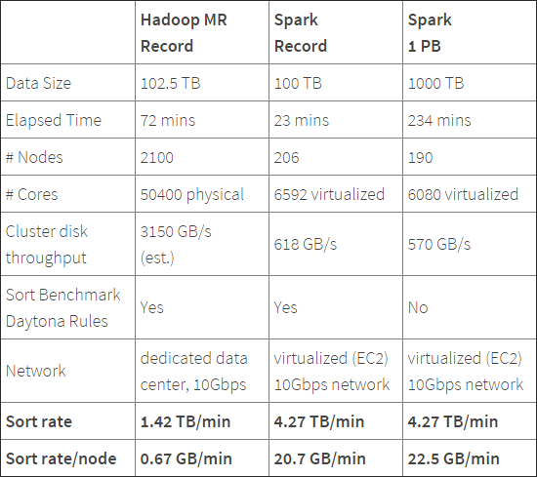
100TB Daytona Sort Competition 2014
Spark sorted the same data 3X faster
using 10X fewer machines
than Hadoop MR in 2013.
All the sorting took place on disk (HDFS) without using Spark’s in-memory cache!
More info:
http://sortbenchmark.org
http://databricks.com/blog/2014/11/05/spark-officially-sets-a-new-record-in-large-scale-sorting.html
Work by Databricks engineers: Reynold Xin, Parviz Deyhim, Xiangrui Meng, Ali Ghodsi, Matei Zaharia
Notes:
Organizations from around the world often build dedicated sort machines (specialized software and sometimes specialized hardware) to compete in this benchmark.. Spark actually tied for 1st place with a team from University of California San Diego who have been working on creating a specialized sorting system called TritonSort.
Winning this benchmark as a general, fault-tolerant system marks an important milestone for the Spark project. It demonstrates that Spark is fulfilling its promise to serve as a faster and more scalable engine for data processing of all sizes, from GBs to TBs to PBs.
Named after Jim Gray, the benchmark workload is resource intensive by any measure: sorting 100 TB of data following the strict rules generates 500 TB of disk I/O and 200 TB of network I/O.
Requires read and write of 500 TB of disk I/O and 200 TB of network (b/c you have to replicate the output to make it fault taulerant)
First time a system based on a public cloud system has won

Slide 44
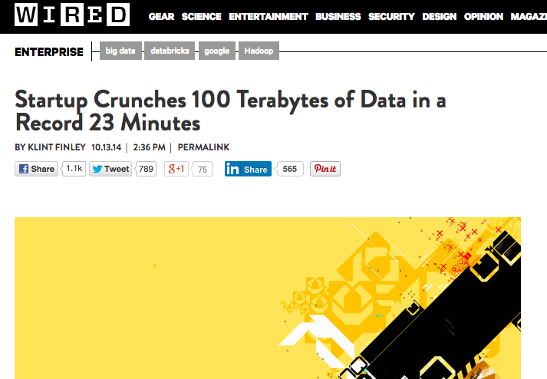
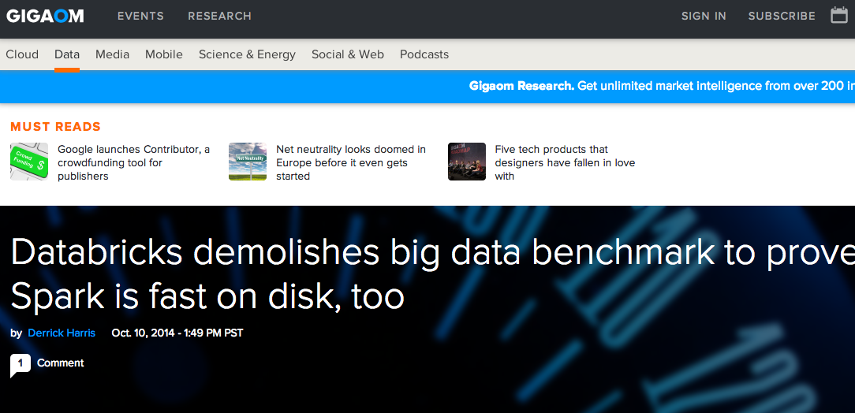

Slide 45
Reference
Why sorting?
- Stresses “shuffle” which underpins everything from SQL to MLlib
- Sorting is challenging b/c there is no reduction in data
- Sort 100 TB = 500 TB disk I/O and 200 TB network
Engineering Investment in Spark:
- Sort-based shuffle (SPARK-2045)
- Netty native network transport (SPARK-2468)
- External shuffle service (SPARK-3796)
Clever Application level Techniques:
- GC and cache friendly memory layout
- Pipelining
Notes:
Zero-Copy (terminology): With Netty, the data from disk only gets sent to one NIC buffer and sent out to other node from there.
Older implementation (normal) would have to first copy to FileSystem kernel buffer cache, then to a Executor JVM user-space buffer, and then to kernel NIC buffer and out to the remove reducer node
GC: Netty does an explicit managed memory, malloc (outside of JVM). Netty is in the normal Executor JVM process that allocates a bunch of memory buffers off-heap and manages these transport buffers entirely by itself.

Slide 46
Reference
Technique used for 100 TB Sort
Intel Xeon CPU E5 2670 @ 2.5 GHz w/ 32 cores
244 GB of RAM
8 x 800 GB SSD and RAID 0 setup formatted with /ext4
~9.5 Gbps (1.1 GBps) bandwidth between 2 random nodes
W
Ex
Each record: 100 bytes (10 byte key & 90 byte value)
OpenJDK 1.7
HDFS 2.4.1 w/ short circuit local reads enabled
Apache Spark 1.2.0
Speculative Execution off
Increased Locality Wait to infinite
Compression turned off for input, output & network
Used Unsafe to put all the data off-heap and managed it manually (i.e. never triggered the GC)
RDD
T
RDD
T
EC2: i2.8xlarge
(206 workers)
32 slots per machine
6,592 slots total
Notes:
In HDFS, reads normally go through the DataNode. Thus, when the client asks the DataNode to read a file, the DataNode reads that file off of the disk and sends the data to the client over a TCP socket. So-called "short-circuit" reads bypass the DataNode, allowing the client to read the file directly. Obviously, this is only possible in cases where the client is co-located with the data. Short-circuit reads provide a substantial performance boost to many applications.
<name>dfs.client.read.shortcircuit</name> <value>true</value>

Slide 47
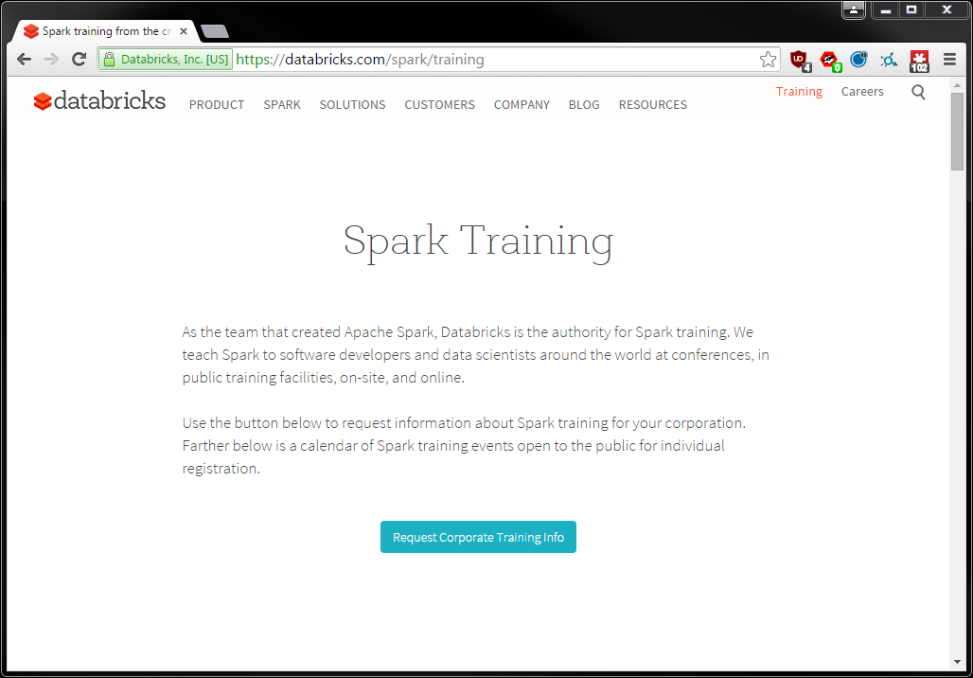
Notes:
Let students know that they can go to Databricks.com to request the expanded 3-day version of this class for their own teams on-site.
Introduce Ben/Tag from NewCircle as our training partner company who students can talk to about purchasing Spark classes

Slide 48
RDD Fundamentals

Slide 49
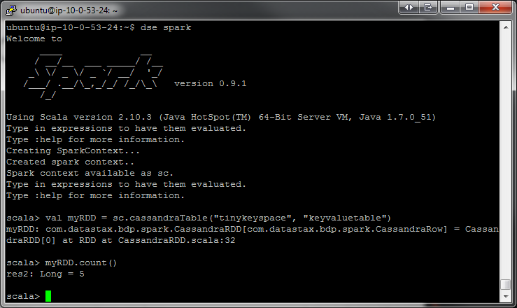
Interactive shell
(Scala & Python only)

Slide 50
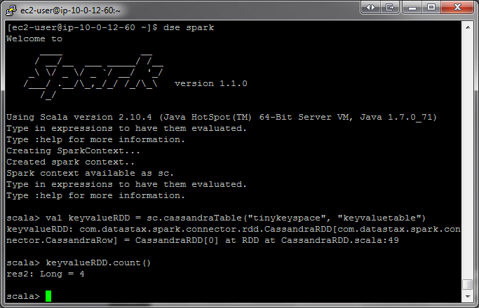
W
Ex
RDD
T
Driver Program
RDD
T
Worker Machine
W
Ex
RDD
T
RDD
T
Worker Machine
Notes:
When you start a driver program, it connects to the Spark Cluster
You can make the Driver HA in standalone by setting the Boolean for –supervise to true when using Spark Submit (https://github.com/apache/spark/search?utf8=%E2%9C%93&q=supervise)
In YARN the driver is HA via YARN primitives

Slide 51
more partitions = more parallelism
RDD
item-1
item-2
item-3
item-4
item-5
item-6
item-7
item-8
item-9
item-10
item-11
item-12
item-13
item-14
item-15
item-16
item-17
item-18
item-19
item-20
item-21
item-22
item-23
item-24
item-25
W
W
W
Ex
Ex
Ex
RDD
RDD
RDD
RDD
RDD
Notes:
This RDD has 5 partitions.
An RDD is simply a distributed collection of elements. You can think of the distributed collections like of like an array or list in your single machine program, except that it’s spread out across multiple nodes in the cluster.
In Spark all work is expressed as either creating new RDDs, transforming existing RDDs, or calling operations on RDDs to compute a result. Under the hood, Spark automatically distributes the data contained in RDDs across your cluster and parallelizes the operations you perform on them.
So, Spark gives you APIs and functions that lets you do something on the whole collection in parallel using all the nodes.

Slide 52
RDD w/ 4 partitions
Error, ts, msg1
Warn, ts, msg2
Error, ts, msg1
Info, ts, msg8
Warn, ts, msg2
Info, ts, msg8
Error, ts, msg3
Info, ts, msg5
Info, ts, msg5
Error, ts, msg4
Warn, ts, msg9
Error, ts, msg1
logLinesRDD
An RDD can be created 2 ways:
- Parallelize a collection
- Read data from an external source (S3, C*, HDFS, etc)
Notes:
----- Meeting Notes (6/15/15 15:53) -----
Each data source feeds the partitions differently.
e.g., Each HDFS block maps to a partition. In Cassandra, by default, 100,000 rows per partition.

Slide 53
Parallelize
# Parallelize in Python
wordsRDD = sc.parallelize([“fish", “cats“, “dogs”])
Take an existing in-memory collection and pass it to SparkContext’s parallelize method
Not generally used outside of prototyping and testing since it requires entire dataset in memory on one machine
// Parallelize in Scala
val wordsRDD= sc.parallelize(List("fish", "cats", "dogs"))
// Parallelize in Java
JavaRDD<String> wordsRDD = sc.parallelize(Arrays.asList(“fish", “cats“, “dogs”));

Slide 54
Read from text file
# Read a local txt file in Python
linesRDD = sc.textFile("/path/to/README.md")
There are other methods to read data from HDFS, C*, S3, HBase, etc.
// Read a local txt file in Scala
val linesRDD = sc.textFile("/path/to/README.md")
// Read a local txt file in Java
JavaRDD<String> lines = sc.textFile("/path/to/README.md");

Slide 55



Error, ts, msg1
Warn, ts, msg2
Error, ts, msg1
Info, ts, msg8
Warn, ts, msg2
Info, ts, msg8
Error, ts, msg3
Info, ts, msg5
Info, ts, msg5
Error, ts, msg4
Warn, ts, msg9
Error, ts, msg1
logLinesRDD
(input/base RDD)
.filter( )
Error, ts, msg1
Error, ts, msg1
Error, ts, msg3
Error, ts, msg4
Error, ts, msg1
errorsRDD
Notes:
Introduce that Spark has Operations which can be transformations or actions.
Those are 4 green unique blocks in a single HDFS file
Here we are filtering out the warnings and info messages so we are left with just errors in the RDD.
This doesn’t actually read the file from HDFS just yet… we’re just building out a lineage graph

Slide 56

Error, ts, msg1
Error, ts, msg1
Error, ts, msg3
Error, ts, msg4
Error, ts, msg1
errorsRDD
.coalesce( 2 )
Error, ts, msg1
Error, ts, msg3
Error, ts, msg1
Error, ts, msg4
Error, ts, msg1
cleanedRDD
.collect( )
Driver

Slide 57
Execute DAG!
.collect( )
Driver
Notes:
directed acyclic graph.
That is, it is formed by a collection of vertices and directed edges, each edge connecting one vertex to another, such that there is no way to start at some vertex v and follow a sequence of edges that eventually loops back to v again.
A collection of tasks that must be ordered into a sequence, subject to constraints that certain tasks must be performed earlier than others, may be represented as a DAG with a vertex for each task and an edge for each constraint
https://en.wikipedia.org/wiki/Directed_acyclic_graph

Slide 58
logLinesRDD
.collect( )
Driver

Slide 59
logLinesRDD
.filter( )
errorsRDD
.coalesce( 2 )
cleanedRDD
.collect( )
Error, ts, msg1
Error, ts, msg3
Error, ts, msg1
Error, ts, msg4
Error, ts, msg1
Driver

Slide 60
logLinesRDD
.filter( )
errorsRDD
.coalesce( 2, shuffle= False)
Pipelined
Stage-1
cleanedRDD
.collect( )
data
Driver
Notes:
----- Meeting Notes (6/15/15 16:02) -----
This is a stage (which we'll talk about later).

Slide 61
logLinesRDD
errorsRDD
cleanedRDD
Driver
Notes:
Now the RDDs dissapear and get destroyed

Slide 62
data
Driver

Slide 63

logLinesRDD
errorsRDD
.saveToCassandra( )
Error, ts, msg1
Error, ts, msg3
Error, ts, msg1
Error, ts, msg4
Error, ts, msg1
cleanedRDD
.filter( )
Error, ts, msg1
Error, ts, msg1
Error, ts, msg1
.count( )
5
errorMsg1RDD
.collect( )

Slide 64
logLinesRDD
errorsRDD
.saveToCassandra( )
Error, ts, msg1
Error, ts, msg3
Error, ts, msg1
Error, ts, msg4
Error, ts, msg1
cleanedRDD
.filter( )
Error, ts, msg1
Error, ts, msg1
Error, ts, msg1
.count( )
5
errorMsg1RDD
.collect( )
Notes:
It’s okay if only part of the RDD actually fits in memory
Talk about lineage: parent RDD and child RDD

Slide 65
Lifecycle of a Spark program
Create some input RDDs from external data or parallelize a collection in your driver program.
Lazily transform them to define new RDDs using transformations like filter() or map()
Ask Spark to cache() any intermediate RDDs that will need to be reused.
Launch actions such as count() and collect() to kick off a parallel computation, which is then optimized and executed by Spark.
Notes:
----- Meeting Notes (6/15/15 16:08) -----
Also note that an application can have many such 1 through 4 procedures.

Slide 66
Transformations
(lazy)
map() | intersection() | cartesion()
flatMap() | distinct() | pipe()
filter() | groupByKey() | coalesce()
mapPartitions() | reduceByKey() | repartition()
mapPartitionsWithIndex() | sortByKey() | partitionBy()
sample() | join() | ...
union() | cogroup() | ...
Most transformations are element-wise (they work on one element at a time), but this is not true for all transformations

Slide 67
Actions
reduce() | takeOrdered()
collect() | saveAsTextFile()
count() | saveAsSequenceFile()
first() | saveAsObjectFile()
take() | countByKey()
takeSample() | foreach()
saveToCassandra() | ...
Notes:
Actions force the evaluation of the transformations required for the RDD they are called on, since they are required to actually produce output.

Slide 68
Types of RDDs
HadoopRDD
FilteredRDD
MappedRDD
PairRDD
ShuffledRDD
UnionRDD
PythonRDD
DoubleRDD
JdbcRDD
JsonRDD
SchemaRDD
VertexRDD
EdgeRDD
CassandraRDD (DataStax)
GeoRDD (ESRI)
EsSpark (ElasticSearch)

Slide 69
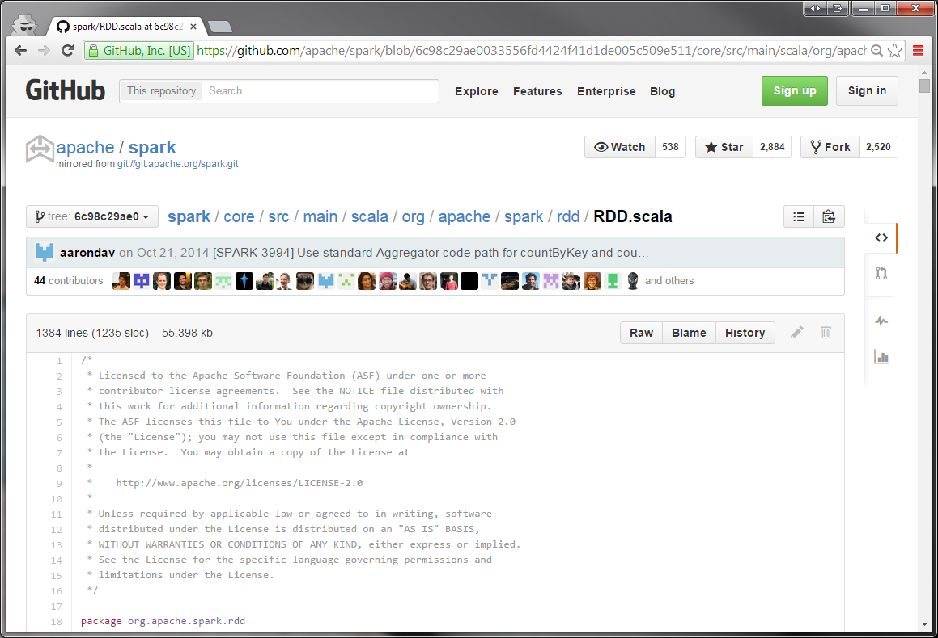
Notes:
This is an abstract class…

Slide 70
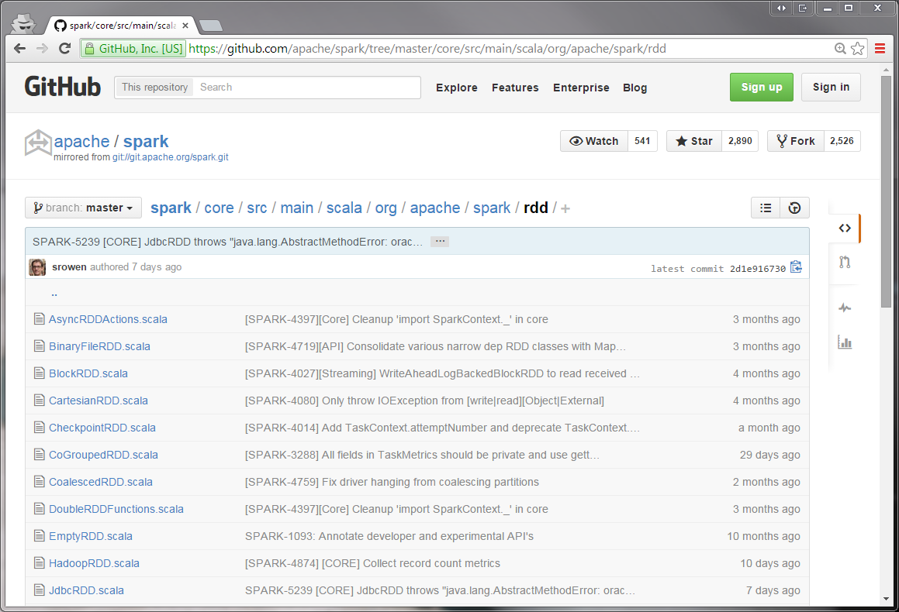

Slide 71
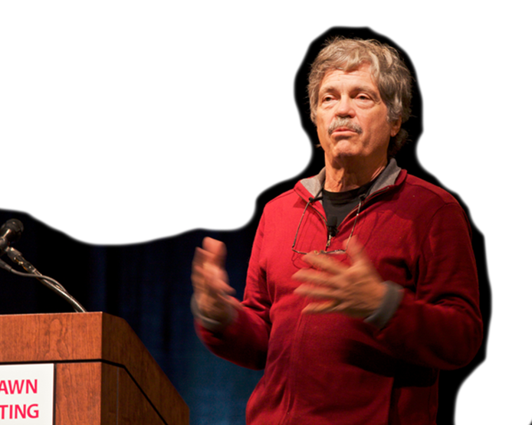
“Simple things should be simple, complex things should be possible”
Alan Kay

Slide 72
Demo: Databricks GUI
Notes:
----- Meeting Notes (6/15/15 16:08) -----
From here, go to DBC and the lab. From there, to Adam's deck. Then, back here after Adam's deck and Adam's lab.

Slide 73
https://classeast01.cloud.databricks.com
- 60 user accounts
- 60 user clusters
- 1 community cluster
https://classeast02.cloud.databricks.com
- Users: 1000 – 1980
- 60 user accounts
- 60 user clusters
- 1 community cluster
- Users: 1000 – 1980

Slide 74
Databricks Guide (5 mins)
DevOps 101 (30 mins)
Transformations &
Actions (30 mins)
DevOps 102 (30 mins)
SQL 101 (30 mins)
Dataframes (20 mins)

Slide 75
Switch to Transformations & Actions slide deck….

Slide 76
UserID | Name | Age | Location | Pet
28492942 | John Galt | 32 | New York | Sea Horse
95829324 | Winston Smith | 41 | Oceania | Ant
92871761 | Tom Sawyer | 17 | Mississippi | Raccoon
37584932 | Carlos Hinojosa | 33 | Orlando | Cat
73648274 | Luis Rodriguez | 34 | Orlando | Dogs
Spark SQL + DataFrames

Slide 77




JDBC/ODBC
Your App
SQL
Notes:
Apache Parquet is a columnar storage format available to any project in the Hadoop ecosystem
Simba: Supports all major on-premise and cloud Spark distributions
Supports all common data types
Maps SQL to Spark SQL
Only direct, universal ODBC 3.52 data access solution for Apache Spark

Slide 78
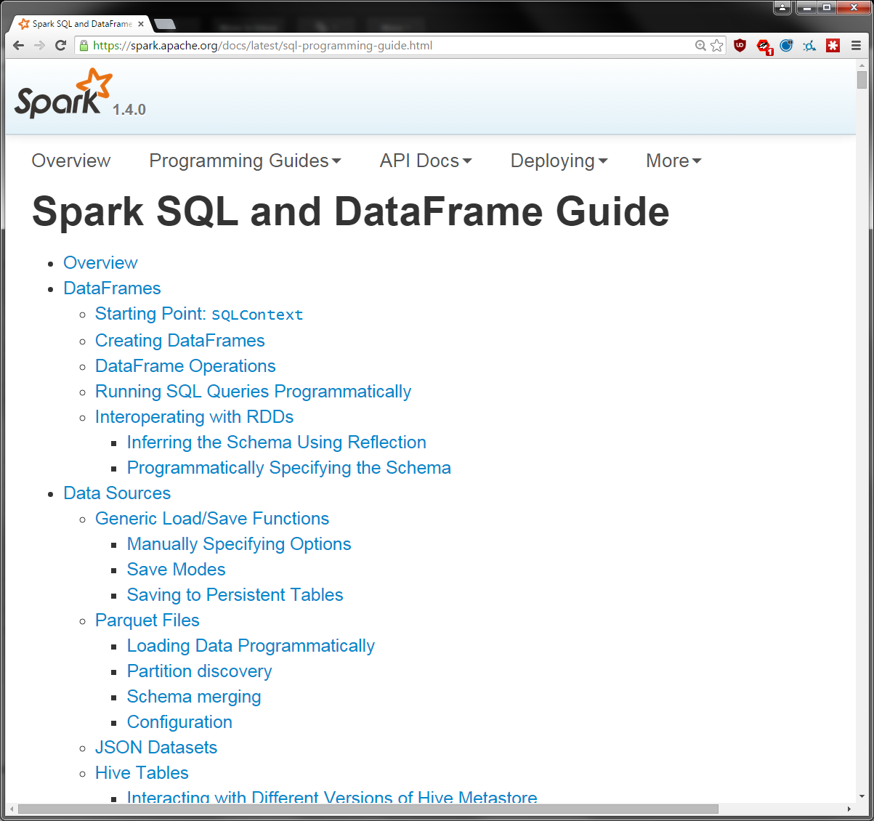

Slide 79
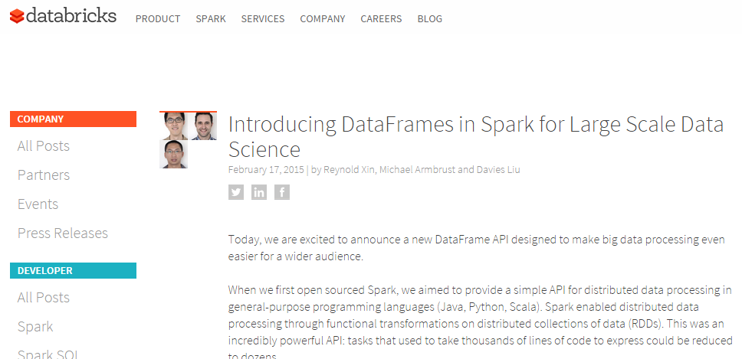
https://databricks.com/blog/2015/02/17/introducing-dataframes-in-spark-for-large-scale-data-science.html

Slide 80
Dataframes
What is a Dataframe?
a distributed collection of data organized into named columns
Like a table in a relational database
Announced Feb 2015
Inspired by data frames in R and Pandas in Python
Works in:
Features
Scales from KBs to PBs
Supports wide array of data formats and storage systems (Hive, existing RDDs, etc)
State-of-the-art optimization and code generation via Spark SQL Catalyst optimizer
APIs in Python, Java
Notes:
Although inspired by data frames in R and Python (Pandas), Spark Dataframes was designed from the ground-up to support modern big data and data science applications.

Slide 81
Dataframes
Step 1: Construct a DataFrame
from pyspark.sql import SQLContext
sqlContext = SQLContext(sc)
df = sqlContext.jsonFile("examples/src/main/resources/people.json")
# Displays the content of the DataFrame to stdout
df.show()
## age name
## null Michael
## 30 Andy
## 19 Justin
Notes:
With a SQLContext, applications can create DataFrames from an existing RDD, from a Hive table, or from data sources.
As an example, the following creates a DataFrame based on the content of a JSON file:

Slide 82
Dataframes
Step 2: Use the DataFrame
# Print the schema in a tree format
df.printSchema()
## root
## |-- age: long (nullable = true)
## |-- name: string (nullable = true)
# Select only the "name" column
df.select("name").show()
## name
## Michael
## Andy
## Justin
# Select everybody, but increment the age by 1
df.select("name", df.age + 1).show()
## name (age + 1)
## Michael null
## Andy 31
## Justin 20
Notes:
Once built, DataFrames provide a domain-specific language for distributed data manipulation.
Here we include some basic examples of structured data processing using DataFrames:

Slide 83
Dataframes
SQL Integration
from pyspark.sql import SQLContext
sqlContext = SQLContext(sc)
df = sqlContext.sql("SELECT * FROM table")
Notes:
The sql function on a SQLContext enables applications to run SQL queries programmatically and returns the result as a DataFrame.

Slide 84
Dataframes
SQL + RDD Integration
2 methods for converting existing RDDs into DataFrames:
Use reflection to infer the schema of an RDD that contains different types of objects
Use a programmatic interface that allows you to construct a schema and then apply it to an existing RDD.
(more concise)
(more verbose)
Notes:
The 1st method works well when you already know the schema while writing your Spark application.
While the 2nd method is more verbose, it allows you to construct DataFrames when the columns and their types are not known until runtime.

Slide 85
Dataframes
SQL + RDD Integration: via reflection
# sc is an existing SparkContext.
from pyspark.sql import SQLContext, Row
sqlContext = SQLContext(sc)
# Load a text file and convert each line to a Row.
lines = sc.textFile("examples/src/main/resources/people.txt")
parts = lines.map(lambda l: l.split(","))
people = parts.map(lambda p: Row(name=p[0], age=int(p[1])))
# Infer the schema, and register the DataFrame as a table.
schemaPeople = sqlContext.inferSchema(people)
schemaPeople.registerTempTable("people")
Notes:
Spark SQL can convert an RDD of Row objects to a DataFrame, inferring the datatypes.
Rows are constructed by passing a list of key/value pairs as kwargs to the Row class.
The keys of this list define the column names of the table, and the types are inferred by looking at the first row. Since we currently only look at the first row, it is important that there is no missing data in the first row of the RDD.
In future versions we plan to more completely infer the schema by looking at more data, similar to the inference that is performed on JSON files.

Slide 86
Dataframes
SQL + RDD Integration: via reflection
# SQL can be run over DataFrames that have been registered as a table.
teenagers = sqlContext.sql("SELECT name FROM people WHERE age >= 13 AND age <= 19")
# The results of SQL queries are RDDs and support all the normal RDD operations.
teenNames = teenagers.map(lambda p: "Name: " + p.name)
for teenName in teenNames.collect():
print teenName
Notes:
Spark SQL can convert an RDD of Row objects to a DataFrame, inferring the datatypes.
Rows are constructed by passing a list of key/value pairs as kwargs to the Row class.
The keys of this list define the column names of the table, and the types are inferred by looking at the first row. Since we currently only look at the first row, it is important that there is no missing data in the first row of the RDD.
In future versions we plan to more completely infer the schema by looking at more data, similar to the inference that is performed on JSON files.

Slide 87
Dataframes
SQL + RDD Integration: via programmatic schema
DataFrame can be created programmatically with 3 steps:
Create an RDD of tuples or lists from the original RDD
Create the schema represented by a StructType matching the structure of tuples or lists in the RDD created in the step 1
Apply the schema to the RDD via createDataFrame method provided by SQLContext
Notes:
When a dictionary of kwargs cannot be defined ahead of time (for example, the structure of records is encoded in a string, or a text dataset will be parsed and fields will be projected differently for different users), a DataFrame can be created programmatically with three steps.
1) Create an RDD of tuples or lists from the original RDD;
2) Create the schema represented by a StructType matching the structure of tuples or lists in the RDD created in the step 1.
3) Apply the schema to the RDD via createDataFrame method provided by SQLContext.

Slide 88
Dataframes
Step 1: Construct a DataFrame
# Constructs a DataFrame from the users table in Hive.
users = context.table("users")
# from JSON files in S3
logs = context.load("s3n://path/to/data.json", "json")
Notes:
The following example shows how to construct DataFrames in Python. A similar API is available in Scala and Java.

Slide 89
Dataframes
Step 2: Use the DataFrame
# Create a new DataFrame that contains “young users” only
young = users.filter(users.age < 21)
# Alternatively, using Pandas-like syntax
young = users[users.age < 21]
# Increment everybody’s age by 1
young.select(young.name, young.age + 1)
# Count the number of young users by gender
young.groupBy("gender").count()
# Join young users with another DataFrame called logs
young.join(logs, logs.userId == users.userId, "left_outer")
Notes:
Once built, DataFrames provide a domain-specific language for distributed data manipulation. Here is an example of using DataFrames to manipulate the demographic data of a large population of users:

Slide 90
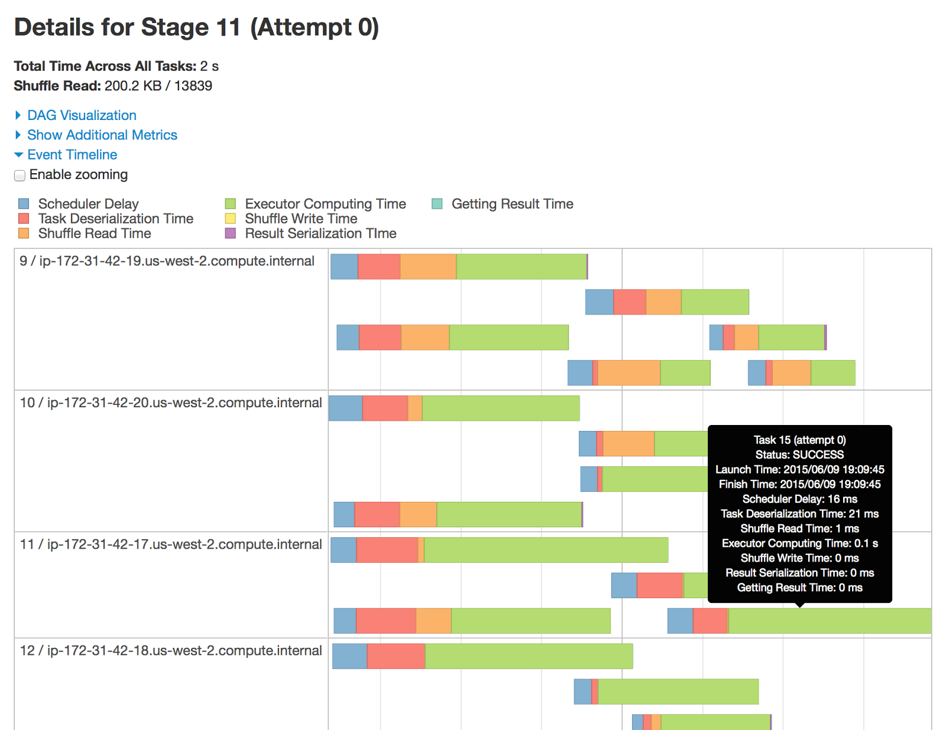
Spark UI

Slide 91
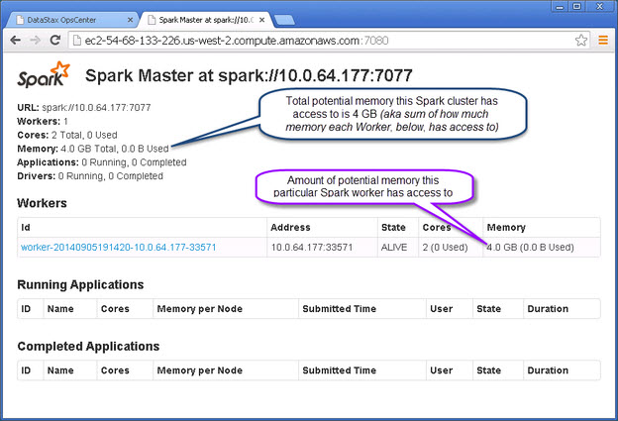
Notes:
None of the cores or memory has been given out by this Spark Worker yet

Slide 92
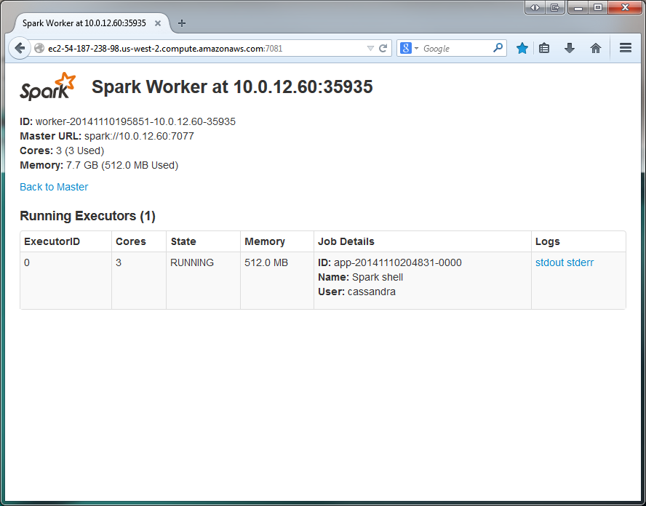
Notes:
Technically a misconfiguring: Worker has given all its cores to the running executor, but not all of its memory. It cannot start any more executors, because it’s out of cores. It might as well have given out all its memory. Why did this happen? Because programmer constrained the memory (asking for 512M). If the programmer hadn’t put a memory limit on the request, the worker would’ve been “greedy”, giving all available memory to the one executor. (Only one executor would’ve been able to run, just as with the above setup.) ONLY APPLIES TO STANDALONE RESOURCE MANAGER.

Slide 93
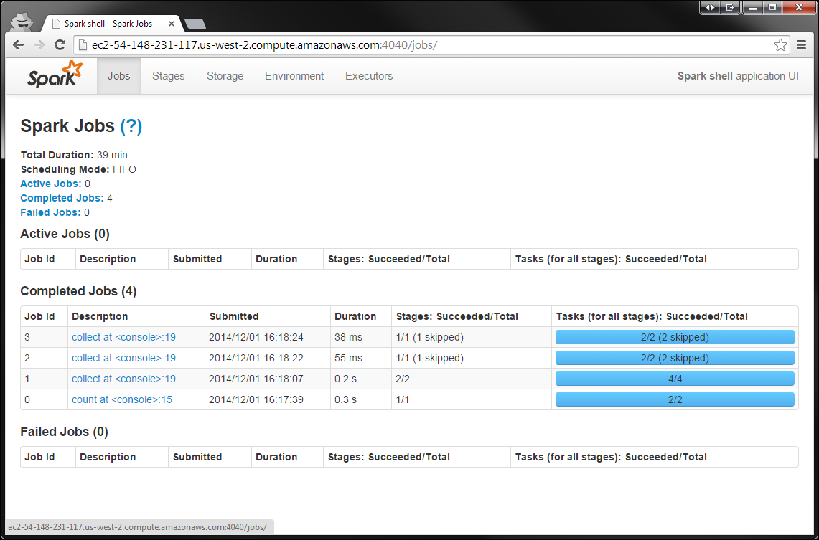
Notes:
This UI comes from the driver JVM.
The jobs page contains detailed execution information for active and recently completed Spark jobs. One very useful piece of information on this page is the progress of running
jobs, stages, and tasks. Within each stage, this page provides several metrics that can be used to better understand physical execution.
A common use for this page is to assess the performance of a job. A good first step is to look through the stages which make up a job and see whether there are stages that are
particularly slow or vary significantly in response time across multiple runs of the same job. If you have an especially expensive stage, you can click through and better understand what user code the stage is associated with.

Slide 94
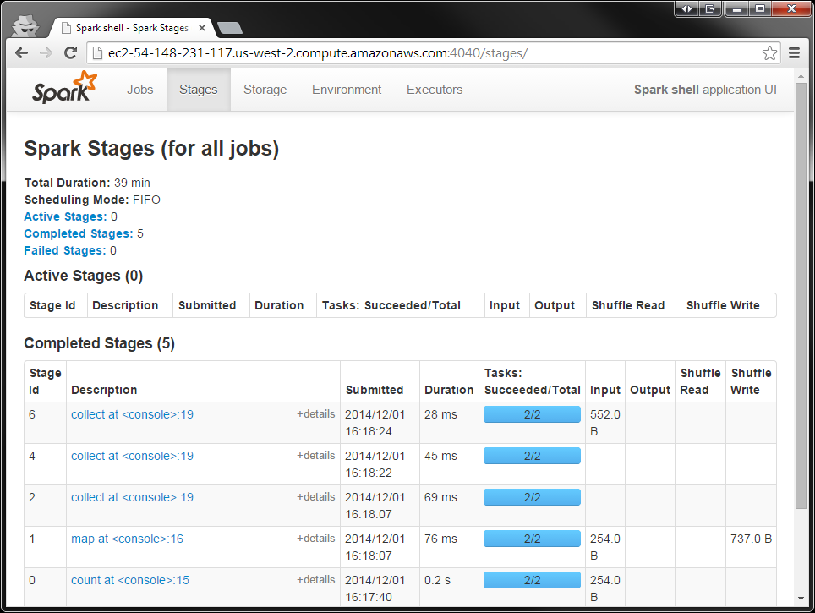
Notes:
A job breaks down into one or more stages. Don’t worry too much about that right now; it’s an intermediate topic. But, once you get into dealing with stages, there’s a UI that exposes information about them.
The first stop for learning about the behavior and performance of a Spark application is Spark’s built-in web UI. This is available at the machine where the driver is running at port 4040 by default. On caveat is that in the case of YARN cluster mode, where the application driver runs inside of the cluster, you should access the UI through the ResourceManager, which proxies requests directly to the driver.
Once you’ve narrowed down a stage of interest, the stage page can help isolate performance issues. In data-parallel systems such as Spark, a common source of performance
issues is skew, which occurs when a small number of tasks take a very large amount of time and hurt the overall performance. The stage page can help you identify skew by
looking at the distribution of different metrics over all tasks. A good starting point is the runtime of the task; do a few tasks take much more time than others? If this is the case, you can dig deeper and see what is causing the tasks to be slow. Do a small number of tasks read or write much more data than others? Are tasks running on certain nodes very slow? These are useful first steps when debugging a job.
In addition to looking at task skew, it can be helpful to identify how much time tasks are spending in each of the phases of the task lifecycle: reading, computing, and writing.
If tasks spend very little time reading or writing data, but take a long time overall, it can be the case that user code itself is expensive. Some tasks may spend almost all of
their time reading data from an external storage system, and will not benefit much from additional optimization in Spark since they are bottlenecked on input read.

Slide 95
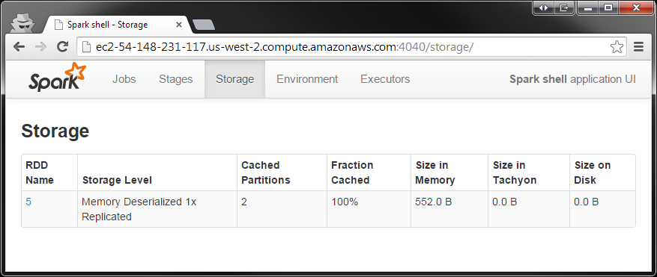
Notes:
The storage page contains information about persisted (cached) RDDs. An RDD is persisted if someone called persist() on the RDD and it was later computed in some job. In some cases, if many RDDs are cached, older ones will fall out of memory to make space for newer ones. This page will tell you exactly what fraction of each RDD is cached and the quantity of data cached in various storage media (disk, memory, etc). It can be good to scan this page and understand whether important datasets are fitting into memory or not.

Slide 96
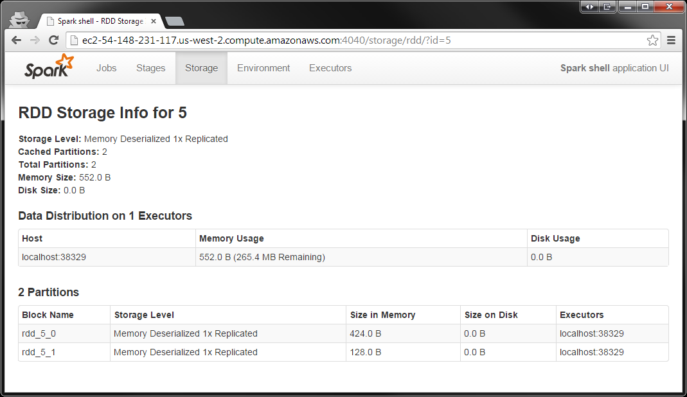
Notes:
This is the screen you see after clicking on the RDD name on the previous slide. NOTE: This is local mode. You can tell because the executor says “localhost” and both executors are on the same port.

Slide 97
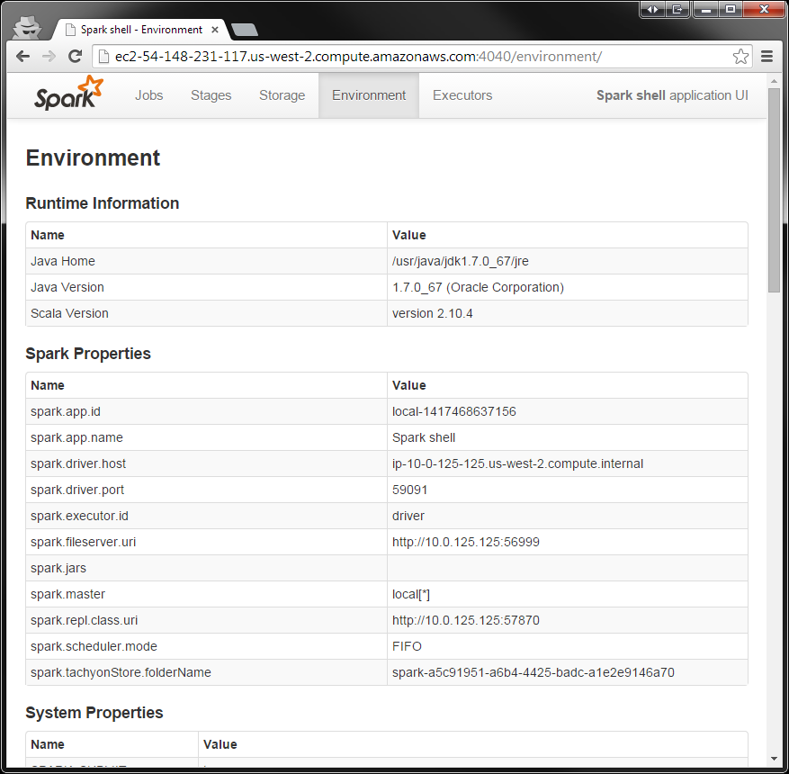
Notes:
This section enumerates the set of active properties in the environment of your Spark application. The configuration here represents the “ground truth” of your application’s
configuration. It can be helpful if you are debugging which configuration flags are enabled, especially if you are using multiple configuration mechanisms. This page will also
enumerate jars and files you’ve added to your application, which can be useful when tracing down issues such as missing dependencies.

Slide 98
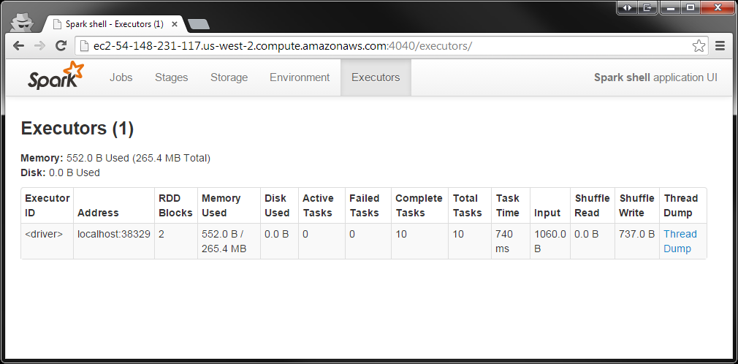
Notes:
This page enumerates the active executors in the application along with some metrics around the processing and storage on each executor. One valuable use of this page is to confirm that your application has the amount of resources you were expecting. A good “first step” when debugging issues to scan this page, since a misconfiguration resulting in fewer executors than expected can, for obvious reasons, hurt performance. It can also be useful to look for executors with anomalous behaviors, such as a very large ratio of failed to successful tasks. An executor with a high failure rate could indicate a misconfiguration or failure on the physical host in question. Simply removing that host from the cluster can improve performance.

Slide 99
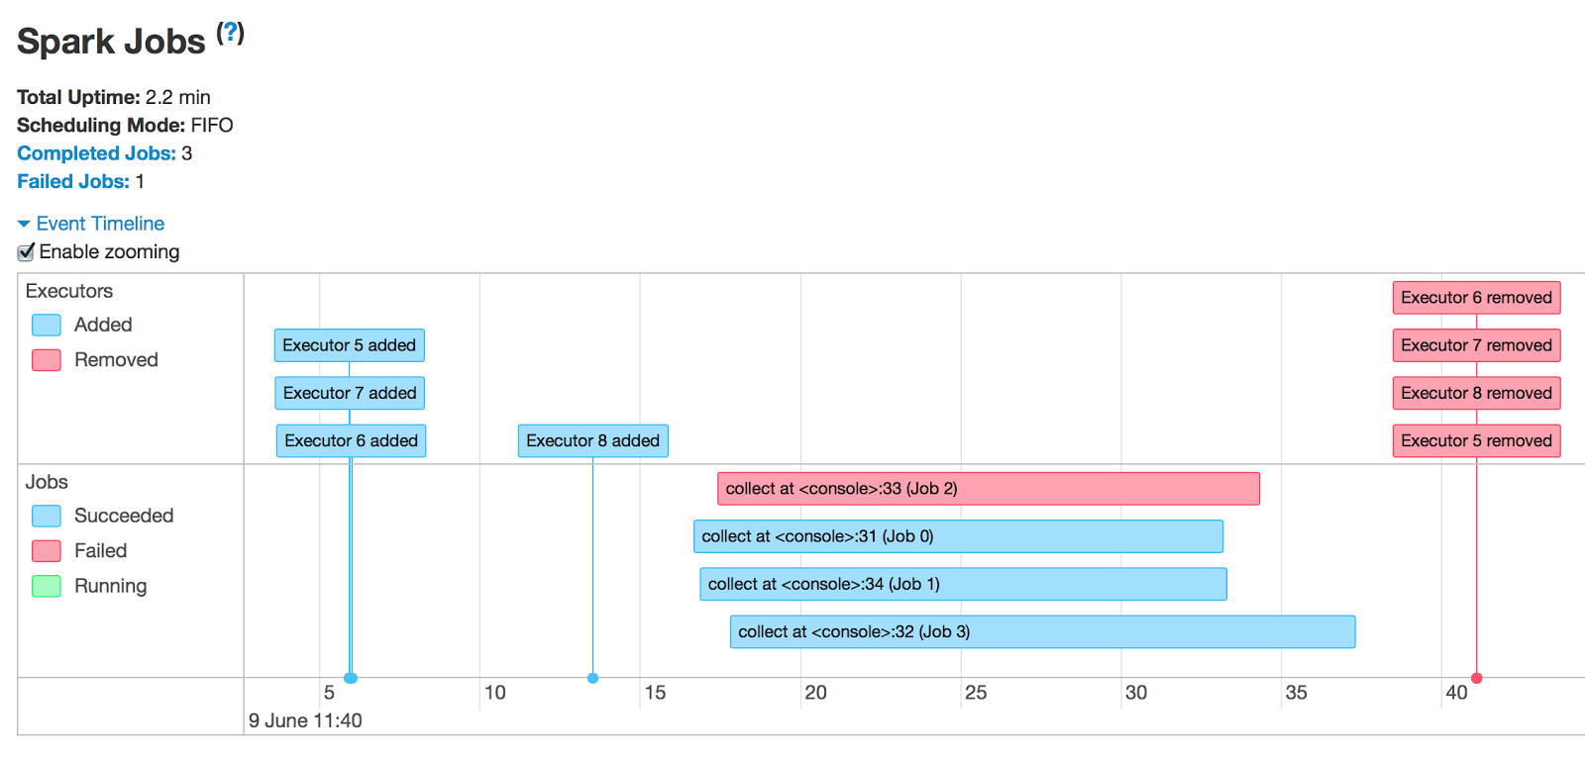
1.4.0
Event timeline all jobs page
Notes:
Production Spark programs can be complex, with long workflows comprised of many different stages. Spark 1.4 adds visual debugging and monitoring utilities to understand the runtime behavior of Spark applications. An application timeline viewer profiles the completion of stages and tasks inside a running program.
A job correlates 1:1 with an action (e.g., a collect(), a count(), etc.).
All the visualizations here do is capture the existing metrics that were shown before in Spark 1.3 and prior

Slide 100
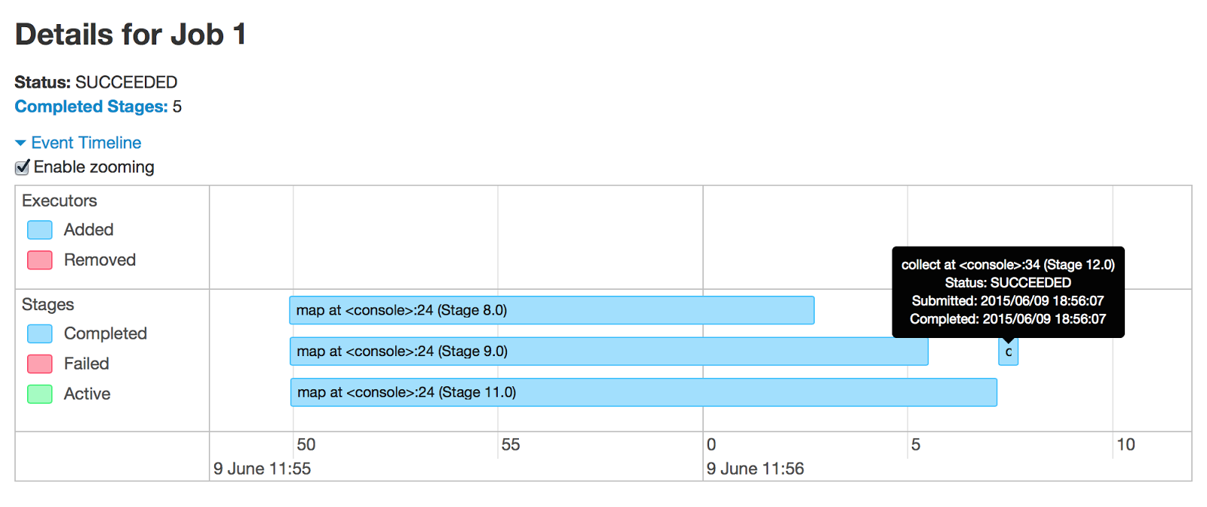
1.4.0
Event timeline within 1 job
Notes:
- First running 3 stages in parallel, then a 4th stage with collect
- These stages ran in about 15-20 seconds
- Why 5 stages? There’s a hidden stage behind the tooltip

Slide 101
1.4.0
Event timeline within 1 stage
Notes:
Now we have clicked on a stage
The color bars are representing a single task
This info is gathered via internal metrics in Spark, exposed via REST
Most tasks spend majority of the time doing real processing work (green)
Scheduler delay: is driver -> executor shipping of task (mostly network delay)
In this stage, since there’s no shuffle write time, we can conclude that it’s a result stage as opposed to a shuffle map stage
The x axis is time
The y axis just shows what’s running in parallel
On node 9, there are at most 2 tasks running in parallel. So there are num_cores = 2 on this exec

Slide 102
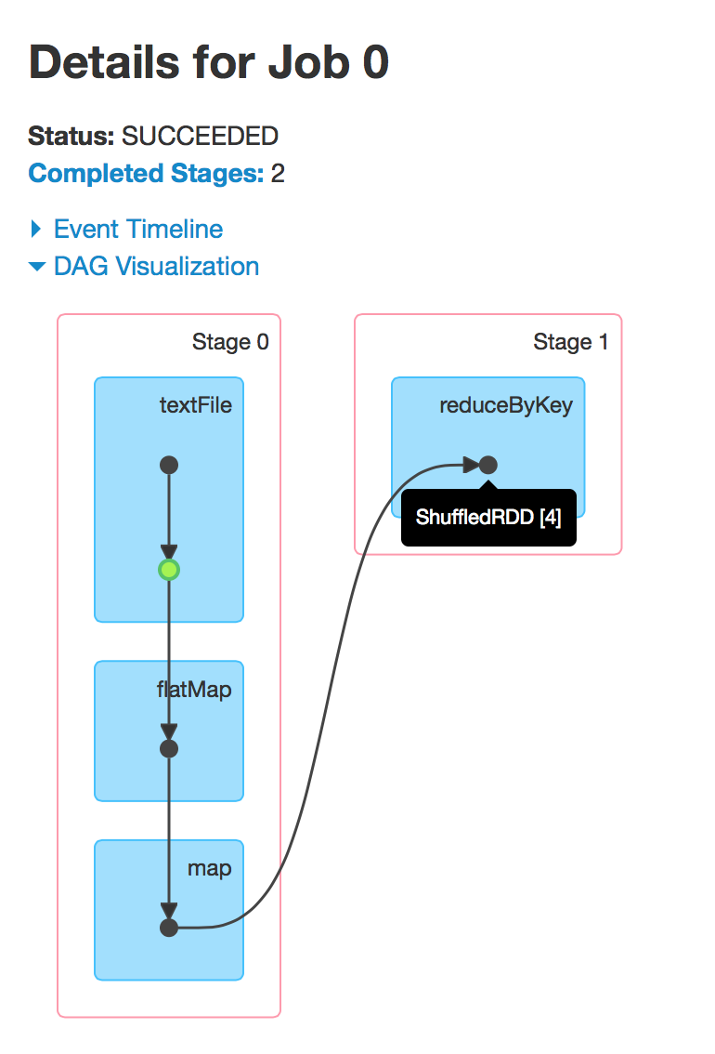
1.4.0
sc.textFile(“blog.txt”)
.cache()
.flatMap { line => line.split(“ “) }
.map { word => (word, 1) }
.reduceByKey { case (count1, count2) => count1 + count2 }
.collect()
Notes:
Spark 1.4 also exposes a visual representation of the underlying computation graph (or “DAG”) that is tied directly to metrics of physical execution. Spark streaming adds visual monitoring over data streams, to continuously track the latency and throughput.
It’s doing a wordcount
Little black dots = RDDs
Green dot = Cached RDD (if you mouse over it, you can see name or type of RDD)
Why are there two stages? Because of the shuffle boundary. Because shuffling goes over the network, it has to force a new stage.
Andrew Or designed this DAG visualization

Slide 103
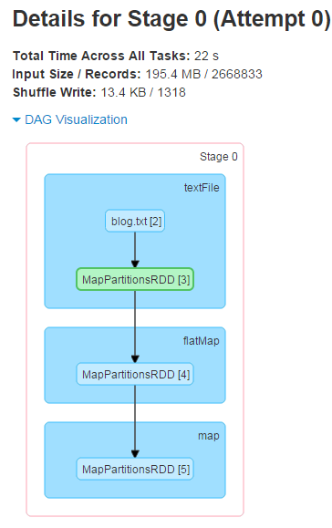
1.4.0
Notes:
Looking at Stage 0 here (specific RDD types)

Slide 104

Spark Resource Managers

Slide 105

What are Tasks?
logLinesRDD
Task-1
Task-2
Task-3
Task-4
errorsRDD
Notes:
Each task runs on a slot. Task equates to partition. For each partition, you need a task.
A task is an item of work that runs on a slot. A slot is a thread. Analogy: thread pools.

Slide 106
Survey completed by 58 out of 115 students
How will you deploy Spark?

Slide 107
Survey completed by 58 out of 115 students
Where will you deploy Spark?

Slide 108
History:
2 MR Apps running
JT
NN
JobTracker
NameNode
TT
DN
TT
DN
TT
DN
TT
DN
M
R
M
R
M
R
M
R
M
M
R
M
R
M
R
M
M
M
R
M
M
M
OS
OS
OS
OS
Notes:
Mention that in MR, you get parallelism with different process IDs, maps & reducers. There can be an issue with a slot being unused for like 15 - 20seconds though, which a new map is being assigned. This is why Facebook made Corona in 2012.
Ask how often TaskTracker heartbeats with the JobTracker? Every 3 seconds.. So there can be at least a 3 second delay when scheduling a job.
But in Spark you get parallelism with different threads.
In MR the slots are hardcoded as either M or R, but not in Spark
- In MR it is recommended that each task run for 30 – 60 seconds, but in Spark a task can be as short as 200 ms
“ During the given period, MapReduce took around 66 seconds to refill a slot, while Corona took around 55 seconds (an improvement of approximately 17%). In a benchmark run in our simulation cluster, the slot refill times dropped from 10 seconds with MapReduce to 600 milliseconds with Corona.”
“In heavy workloads during our testing, the utilization in the Hadoop MapReduce system topped out at 70%. Corona was able to reach more than 95%.”
“The job tracker could not handle its dual responsibilities (1) managing the cluster resources and 2) scheduling all user jobs. ) adequately. At peak load, cluster utilization would drop precipitously due to scheduling overhead.” “Another limitation of the Hadoop MapReduce framework was its pull-based scheduling model. Task trackers provide a heartbeat status to the job tracker in order to get tasks to run. Since the heartbeat is periodic, there is always a pre-defined delay when scheduling tasks for any job. For small jobs this delay was problematic.”
“Hadoop MapReduce is also constrained by its static slot-based resource management model. Rather than using a true resource management system, a MapReduce cluster is divided into a fixed number of map and reduce slots based on a static configuration – so slots are wasted anytime the cluster workload does not fit the static configuration. Furthermore, the slot-based model makes it hard for non-MapReduce applications to be scheduled appropriately.”
“ Corona introduces a cluster manager whose only purpose is to track the nodes in the cluster and the amount of free resources. A dedicated job tracker is created for each job, and can run either in the same process as the client (for small jobs) or as a separate process in the cluster (for large jobs). One major difference from our previous Hadoop MapReduce implementation is that Corona uses push-based, rather than pull-based, scheduling. After the cluster manager receives resource requests from the job tracker, it pushes the resource grants back to the job tracker. Also, once the job tracker gets resource grants, it creates tasks and then pushes these tasks to the task trackers for running. There is no periodic heartbeat involved in this scheduling, so the scheduling latency is minimized.”
Corona:
https://www.facebook.com/notes/facebook-engineering/under-the-hood-scheduling-mapreduce-jobs-more-efficiently-with-corona/10151142560538920

Slide 109
Ways to run Spark
Local
Standalone Scheduler
YARN
Mesos
Notes:
Static vs. Dynamic doesn’t refer to RDD partitioning here…
In cluster mode Spark depends on a cluster manager to launch executors and, in certain cases, to launch the driver. The cluster manager is a pluggable component in Spark.
Each one of these resource managers has different pros and cons. One nice thing about running Spark in YARN, for example, is that you can dynamically resize the # of Executors in the application. This feature is not yet possible in Standalone mode.
Static Partitioning: With this approach, each application is given a maximum amount of resources it can use, and holds onto them for its whole duration.
Mesos: In “fine-grained” mode (default), each Spark task runs as a separate Mesos task. This allows multiple instances of Spark (and other frameworks) to share machines at a very fine granularity, where each application gets more or fewer machines as it ramps up and down, but it comes with an additional overhead in launching each task. This mode may be inappropriate for low-latency requirements like interactive queries or serving web requests.
In Standalone and Mesos course-grained, you can control the maximum number of resources Spark will acquire. By default, it will acquire all cores in the cluster (that get offered by Mesos), which only makes sense if you run just one application at a time. You can cap the max # of cores using conf.set("spark.cores.max", "10") (for example).
Standalone mode: By default, applications submitted to the standalone mode cluster will run in FIFO (first-in-first-out) order, and each application will try to use all available nodes. You can limit the number of nodes an application uses by setting the spark.cores.maxconfiguration property in it, or change the default for applications that don’t set this setting through spark.deploy.defaultCores. Finally, in addition to controlling cores, each application’s spark.executor.memory setting controls its memory use.
YARN: The --num-executors option to the Spark YARN client controls how many executors it will allocate on the cluster, while --executor-memory and --executor-cores control the resources per executor.
The “coarse-grained” mode will instead launch only one long-running Spark task on each Mesos machine, and dynamically schedule its own “mini-tasks” within it. The benefit is much lower startup overhead, but at the cost of reserving the Mesos resources for the complete duration of the application

Slide 110
Local mode

Slide 111

Local mode
CPUs:
3 options:
- local
- local[N]
- local[*]
JVM: Ex + Driver
RDD, P1
Task
Task
RDD, P1
Task
Task
> ./bin/spark-shell --master local[12]
RDD, P2
Task
Task
RDD, P2
Task
Task
RDD, P3
Task
Task
Task
Task
> ./bin/spark-submit --name "MyFirstApp"
--master local[12] myApp.jar
Internal Threads
val conf = new SparkConf()
.setMaster("local[12]")
.setAppName(“MyFirstApp")
.set("spark.executor.memory", “3g")
val sc = new SparkContext(conf)
Worker Machine
Disk
Notes:
Local – run spark with one worker thread
Local[N] – run spark with N worker threads . Again, think thread pool.
Local[*] – run Spark with as many worker threads as logical cores on your machine
Note, that in local mode a shuffle is not costly! Not good for real performance testing.
Spark can efficiently support tasks as short as 200 ms
- - - -
There are a lot of internal threads (I think shuffle servers alone have 8 threads?), but most of them are just idle and don't do much so I wouldn't worry about the overhead.
You can launch a spark shell on a single node and then run jstack to see what all the threads are doing.
- - -Ask Reynold: In local mode, can students still change the % of memory allocated to tasks vs shuffle vs user code? A) Yes, same thing.

Slide 112
standalone mode

Slide 113



Spark S andalone
different spark-env.sh
- SPARK_WORKER_CORES
W
W
W
W
Ex
Ex
Ex
Ex
RDD, P1
T
T
RDD, P4
T
T
RDD, P5
T
T
RDD, P7
T
T
RDD, P2
T
T
RDD, P6
T
T
RDD, P3
T
T
RDD, P8
T
T
RDD, P1
T
T
RDD, P1
T
T
RDD, P2
T
T
RDD, P2
T
T
T
T
Internal Threads
T
T
Internal Threads
Internal Threads
Internal Threads
Driver
Spark Master
OS Disk
SSD
SSD
OS Disk
SSD
SSD
OS Disk
SSD
SSD
OS Disk
SSD
SSD
SSD
SSD
SSD
SSD
SSD
SSD
SSD
SSD
> ./bin/spark-submit --name “SecondApp"
--master spark://host4:port1
myApp.jar
vs.
spark-env.sh
- SPARK_LOCAL_DIRS
Notes:
Mention how much RAM to give each JVM
Mention that OOMs can happen in the driver or executor
There will be 3 masters and the workers… when they start up, they ask ZK where the active master is.
How to separate RDD caches on disk from shuffle data? A) It is not possible right now
Spark_local_dirs: (SSDs) Directory to use for "scratch" space in Spark, including map output files and RDDs that get stored on disk. This should be on a fast, local disk in your system. It can also be a comma-separated list of multiple directories on different disks. NOTE: In Spark 1.0 and later this will be overriden by SPARK_LOCAL_DIRS (Standalone, Mesos) or LOCAL_DIRS (YARN) environment variables set by the cluster manager
- -
On the 2nd machine, we have SPARK_WORKER_CORES set to 10, instead of 6 like all the other machines.
Note, there’s no way to tell a worker that has SPARK_WORKER_CORES set to 15 to just launch Executors with only 10 cores. However, you can start an entire Spark application and say that you only want ‘x’ cores and then some workers will launch Executors, but other workers will not. This could lead to a bit of unbalanced cluster.
- - - -
ZooKeeper:
Utilizing ZooKeeper to provide leader election and some state storage, you can launch multiple Masters in your cluster connected to the same ZooKeeper instance. One will be elected “leader” and the others will remain in standby mode. If the current leader dies, another Master will be elected, recover the old Master’s state, and then resume scheduling. The entire recovery process (from the time the first leader goes down) should take between 1 and 2 minutes. Note that this delay only affects scheduling new applications – applications that were already running during Master failover are unaffected.
After you have a ZooKeeper cluster set up, enabling high availability is straightforward. Simply start multiple Master processes on different nodes with the same ZooKeeper configuration (ZooKeeper URL and directory). Masters can be added and removed at any time.
In order to schedule new applications or add Workers to the cluster, they need to know the IP address of the current leader. This can be accomplished by simply passing in a list of Masters where you used to pass in a single one. For example, you might start your SparkContext pointing to spark://host1:port1,host2:port2. This would cause your SparkContext to try registering with both Masters – if host1 goes down, this configuration would still be correct as we’d find the new leader, host2.
There’s an important distinction to be made between “registering with a Master” and normal operation. When starting up, an application or Worker needs to be able to find and register with the current lead Master. Once it successfully registers, though, it is “in the system” (i.e., stored in ZooKeeper). If failover occurs, the new leader will contact all previously registered applications and Workers to inform them of the change in leadership, so they need not even have known of the existence of the new Master at startup.
Due to this property, new Masters can be created at any time, and the only thing you need to worry about is that new applications and Workers can find it to register with in case it becomes the leader. Once registered, you’re taken care of.

Slide 114
Pluggable Resource Management
 | Spark Central Master | Who starts Executors? | Tasks run in
Local | [none] | Human being | Executor
Standalone | Standalone Master | Worker JVM | Executor
YARN | YARN App Master | Node Manager | Executor
Mesos | Mesos Master | Mesos Slave | Executor

Slide 115

Deploying an app to the cluster
spark-submit provides a uniform interface for submitting jobs across all cluster managers
bin/spark-submit --master spark://host:7077
--executor-memory 10g
my_script.py
Source: Learning Spark

Slide 116
Memory and persistence

Slide 117
Recommended to use at most only 75% of a machine’s memory for Spark
Minimum Executor heap size should be 8 GB
Max Executor heap size depends… maybe 40 GB (watch GC)
Memory usage is greatly affected by storage level and serialization format
Ex
RDD, P1
T
T
RDD, P2
T
T
RDD, P1
T
T
Internal Threads

Slide 118

Vs.
+

Slide 119
Persistence | description
MEMORY_ONLY | Store RDD as deserialized Java objects in the JVM
MEMORY_AND_DISK | Store RDD as deserialized Java objects in the JVM and spill to disk
MEMORY_ONLY_SER | Store RDD as serialized Java objects (one byte array per partition)
MEMORY_AND_DISK_SER | Spill partitions that don't fit in memory to disk instead of recomputing them on the fly each time they're needed
DISK_ONLY | Store the RDD partitions only on disk
MEMORY_ONLY_2, MEMORY_AND_DISK_2 | Same as the levels above, but replicate each partition on two cluster nodes
OFF_HEAP | Store RDD in serialized format in Tachyon

Slide 120

deserialized
JVM
RDD.cache() == RDD.persist(MEMORY_ONLY)
most CPU-efficient option
Notes:
Store RDD as deserialized Java objects in the JVM. If the RDD does not fit in memory, some partitions will not be cached and will be recomputed on the fly each time they're needed. (default)

Slide 121


Slide 122

serialized
JVM
RDD.persist(MEMORY_ONLY_SER)
Notes:
Store RDD as serialized Java objects (one byte array per partition). This is generally more space-efficient than deserialized objects
Remember to chose a fast serialization library if choosing this!
Caching serialized objects will slightly slow down
the cache operation due to the cost of serializing objects, but it can substantially reduce
time spent on garbage collection in the JVM, since many individual records can be
stored as a single serialized buffer. This is because the cost of garbage collection scales
with the number of objects on the heap, not the number of bytes of data, and this caching
method will take many objects and serialize them into a single giant buffer. Consider
this option if you are caching large amounts of data (e.g. Gigabyes) as objects in a single
executor and/or seeing long garbage collection pauses. Such pauses would be visible in
the application UI under the “GC Time” column for each task.

Slide 123
+
W
deserialized
Ex
RDD-P1
T
JVM
RDD-P1
T
RDD-P2
.persist(MEMORY_AND_DISK)
OS Disk
SSD
Notes:
Store RDD as deserialized Java objects in the JVM. If the RDD does not fit in memory, store the partitions that don't fit on disk, and read them from there when they're needed.
Note that just part of a partition cannot spill to disk. The entire partition will spill if it needs to.
To-Do: When it goes down to disk though, it’s always serialized, right?

Slide 124
+
serialized
JVM
.persist(MEMORY_AND_DISK_SER)
Notes:
Similar to MEMORY_ONLY_SER, but spill partitions that don't fit in memory to disk instead of recomputing them on the fly each time they're needed.

Slide 125
JVM
.persist(DISK_ONLY)
Notes:
Similar to MEMORY_ONLY_SER, but spill partitions that don't fit in memory to disk instead of recomputing them on the fly each time they're needed.

Slide 126
deserialized
deserialized
JVM on Node X
JVM on Node Y
RDD.persist(MEMORY_ONLY_2)
Notes:
Store RDD as deserialized Java objects in the JVM. If the RDD does not fit in memory, some partitions will not be cached and will be recomputed on the fly each time they're needed. (default)

Slide 127
+
+
deserialized
deserialized
JVM
JVM
.persist(MEMORY_AND_DISK_2)
Notes:
Store RDD as deserialized Java objects in the JVM. If the RDD does not fit in memory, store the partitions that don't fit on disk, and read them from there when they're needed.
Note that just part of a partition cannot spill to disk. The entire partition will spill if it needs to.
To-Do: When it goes down to disk though, it’s always serialized, right?

Slide 128


JVM-1 / App-1
serialized
Tachyon
JVM-2 / App-1
JVM-7 / App-2
.persist(OFF_HEAP)
Notes:
To-Do: make a node machine all around to show node-level locality
Store RDD in serialized format in Tachyon. Compared to MEMORY_ONLY_SER, OFF_HEAP reduces garbage collection overhead and allows executors to be smaller and to share a pool of memory, making it attractive in environments with large heaps or multiple concurrent applications. Furthermore, as the RDDs reside in Tachyon, the crash of an executor does not lead to losing the in-memory cache. In this mode, the memory in Tachyon is discardable. Thus, Tachyon does not attempt to reconstruct a block that it evicts from memory.

Slide 129
JVM
.unpersist()

Slide 130
?
JVM
Notes:
Spark automatically monitors cache usage on each node and drops out old data partitions in a least-recently-used (LRU) fashion. If you would like to manually remove an RDD instead of waiting for it to fall out of the cache, use the RDD.unpersist() method.

Slide 131


Remember!
Intermediate data is automatically persisted during shuffle operations
Notes:
Spark also automatically persists some intermediate data in shuffle operations (e.g. reduceByKey), even without users calling persist. This is done to avoid recomputing the entire input if a node fails during the shuffle. We still recommend users call persist on the resulting RDD if they plan to reuse it.

Slide 132
Default Memory Allocation in Executor JVM
spark.storage.memoryFraction
User Programs
(remainder)
Shuffle memory
Cached RDDs
spark.shuffle.memoryFraction

Slide 133
Memory
Spark uses memory for:
RDD Storage: when you call .persist() or .cache(). Spark will limit the amount of memory used when caching to a certain fraction of the JVM’s overall heap, set by spark.storage.memoryFraction
Shuffle and aggregation buffers: When performing shuffle operations, Spark will create intermediate buffers for storing shuffle output data. These buffers are used to store intermediate results of aggregations in addition to buffering data that is going to be directly output as part of the shuffle.
User code: Spark executes arbitrary user code, so user functions can themselves
require substantial memory. For instance, if a user application allocates large arrays
or other objects, these will content for overall memory usage. User code has access
to everything “left” in the JVM heap after the space for RDD storage and shuffle
storage are allocated.

Slide 134
Data Serialization
Notes:
When Spark is transferring data over the network or spilling data to disk, it needs to serialize objects into a binary format.
This comes into play during shuffle operations, where potentially large amounts of data are transferred. By default Spark will use Java’s built-in serializer.

Slide 135

Serialization
Serialization is used when:
Transferring data over the network
Spilling data to disk
Caching to memory serialized
Broadcasting variables

Slide 136

Java serialization
vs.
Kryo serialization
Uses Java’s ObjectOutputStream framework
Works with any class you create that implements java.io.Serializable
You can control the performance of serialization more closely by extending java.io.Externalizable
Flexible, but quite slow
Leads to large serialized formats for many classes
Recommended serialization for production apps
Use Kyro version 2 for speedy serialization (10x) and more compactness
Does not support all Serializable types
Requires you to register the classes you’ll use in advance
If set, will be used for serializing shuffle data between nodes and also serializing RDDs to disk
conf.set(“spark.serializer”, "org.apache.spark.serializer.KryoSerializer")
Notes:
The only reason Kryo is not the default is because of the custom registration requirement, but we recommend trying it in any network-intensive application.
Spark automatically includes Kryo serializers for the many commonly-used core Scala classes covered in the AllScalaRegistrar from the Twitter chill library.

Slide 137
Broadcast variables
&
Accumulators
+
+
+
Notes:
One way to avoid shuffles when joining two datasets is to take advantage of broadcast variables. When one of the datasets is small enough to fit in memory in a single executor, it can be loaded into a hash table on the driver and then broadcast to every executor. A map transformation can then reference the hash table to do lookups.

Slide 138
Ex
T
T
x = 5
x = 5
Ex
T
T
x = 5
x = 5
x = 5
Ex
Notes:
When we pass functions to Spark, like map or filter, they can use variables defined outside them in the driver program, but each task running on the cluster gets a new copy of each variable, and updates from these copies are not propagated back to the driver.
Recall that Spark automatically sends all variables referenced in your closures to the
worker nodes. While this is convenient, it can also be inefficient because (1) the default
task launching mechanism is optimized for small task sizes, and (2) you might, in fact,
use the same variable in multiple parallel operations, but Spark will send it separately
for each operation.

Slide 139
Use Cases:
Broadcast variables – Send a large read-only lookup table to all the nodes, or send a large feature vector in a ML algorithm to all nodes
Accumulators – count events that occur during job execution for debugging purposes. Example: How many lines of the input file were blank? Or how many corrupt records were in the input dataset?
+
+
+

Slide 140
Spark supports 2 types of shared variables:
Broadcast variables – allows your program to efficiently send a large, read-only value to all the worker nodes for use in one or more Spark operations. Like sending a large, read-only lookup table to all the nodes.
Accumulators – allows you to aggregate values from worker nodes back to the driver program. Can be used to count the # of errors seen in an RDD of lines spread across 100s of nodes. Only the driver can access the value of an accumulator, tasks cannot. For tasks, accumulators are write-only.
+
+
+
Notes:
One way to avoid shuffles when joining two datasets is to take advantage of broadcast variables. When one of the datasets is small enough to fit in memory in a single executor, it can be loaded into a hash table on the driver and then broadcast to every executor. A map transformation can then reference the hash table to do lookups.

Slide 141
Broadcast Variables
Broadcast variables let programmer keep a read-only variable cached on each machine rather than shipping a copy of it with tasks
For example, to give every node a copy of a large input dataset efficiently
Spark also attempts to distribute broadcast variables using efficient broadcast algorithms to reduce communication cost

Slide 142
Broadcast Variables
Scala:
val broadcastVar = sc.broadcast(Array(1, 2, 3))
broadcastVar.value
Python:
broadcastVar = sc.broadcast(list(range(1, 4)))
broadcastVar.value

Slide 143
Accumulators
+
+
+
Accumulators are variables that can only be “added” to through an associative operation
Used to implement counters and sums, efficiently in parallel
Spark natively supports accumulators of numeric value types and standard mutable collections, and programmers can extend for new types
Only the driver program can read an accumulator’s value, not the tasks

Slide 144
Accumulators
+
+
+
Scala:
val accum = sc.accumulator(0)
sc.parallelize(Array(1, 2, 3, 4)).foreach(x => accum += x)
accum.value
Python:
accum = sc.accumulator(0)
rdd = sc.parallelize([1, 2, 3, 4])
def f(x):
global accum
accum += x
rdd.foreach(f)
accum.value

Slide 145
Next slide is only for on-site students…

Slide 146

tinyurl.com/spark summit intro survey

Slide 147
TwitterUtils.createStream(...) .filter(_.getText.contains("Spark")) .countByWindow(Seconds(5))
Streaming
Notes:
Spark Streaming can handing gigabytes of data per second
Note that Python API was added starting Spark 1.2 (it supports all DSTream transformations and almost all output operations). But it currently only supports basic incoming sources like text files and text data over network sockets (Flume + Kafka support in PySpark coming soon)

Slide 148
Scalable
High-throughput
Fault-tolerant
TCP socket
Kafka
HDFS
Flume
Cassandra
HDFS
Dashboards
S3
Streaming
Databases
Kinesis
Twitter
Complex algorithms can be expressed using:
Spark transformations: map(), reduce(), join(), etc
MLlib + GraphX
SQL
Notes:
Spark Streaming is an extension of the core Spark API that enables scalable, high-throughput, fault-tolerant stream processing of live data streams.
Data can be ingested from many sources like Kafka, Flume, Twitter, ZeroMQ, Kinesis or TCP sockets can be processed using complex algorithms expressed with high-level functions like map,reduce, join and window.
Finally, processed data can be pushed out to filesystems, databases, and live dashboards.
In fact, you can apply Spark’s machine learning and graph processing algorithms on data streams.

Slide 149

Batch
Realtime
Streaming
One unified API

Slide 150

Tathagata Das (TD)
Lead developer of Spark Streaming + Committer on Apache Spark core
Helped re-write Spark Core internals in 2012 to make it 10x faster to support Streaming use cases
On leave from UC Berkeley PhD program
Ex: Intern @ Amazon, Intern @ Conviva, Research Assistant @ Microsoft Research India
Scales to 100s of nodes
Batch sizes as small at half a second
Processing latency as low as 1 second
Exactly-once semantics no matter what fails
Streaming
Notes:
- Streaming Started as research project in 2012 where they had to tear out the internals of the existing version of Spark and had to re-write it to make it 10 times faster than what it was back then.

Slide 151

Use Cases
(live statistics)
Streaming
Page views
Kafka for buffering
Spark for processing

Slide 152


Use Cases
(Anomaly Detection)
Smart meter readings
Join 2 live data sources
Streaming
Live weather data
Notes:
An electric company can join 100s of thousands of live data points from the electric grid with live weather data and apply predictive machine learning algorithms to try to predict that a snow storm might be starting in Denver and to start devoting personnel and resources there to fix grid problems.

Slide 153
Batches every X seconds
Batches of processed data
Input data stream
Streaming
Core
Notes:
Spark Streaming receives live input data streams and divides the data into batches, which are then processed by the Spark engine to generate the final stream of results in batches.

Slide 154
Streaming
Input data streams
Batches of processed data
R
R
Core
R
Batches every X seconds

Slide 155

DStream
(Discretized Stream)
Batch interval = 5 seconds
T = 5
T = 10
Input
DStream
Block #1
Block #2
Block #3
Block #1
Block #2
Block #3
RDD @ T=5
RDD @ T=10
One RDD is created every 5 seconds
Notes:
TO-DO: animate the second one after first.
Spark is built on the idea of RDDs. Likewise, Spark Streaming is build on the idea of Dstreams.
A DStream is a sequence of data arriving over time.
Internally, each DStream is represented as a sequence of RDDs arriving at each time step.
Each RDD in a DStream contains data from a certain interval, as shown in the following figure.

Slide 156
Transforming DStreams
Block #1
Block #2
Block #3
5 sec
linesDStream
Part. #1
Part. #2
Part. #3
linesRDD
flatMap()
wordsDStream
Part. #1
Part. #2
Part. #3
wordsRDD
Notes:
Ask TD: Is that first conversion from Blocks to Partitions called a transformation?
Any operation applied on a DStream translates to operations on the underlying RDDs.
These underlying RDD transformations are computed by the Spark engine. The DStream operations hide most of these details and provide the developer with higher-level API for convenience.

Slide 157


from pyspark import SparkContext
from pyspark.streaming import StreamingContext
# Create a local StreamingContext with two working thread and batch interval of 1 second
sc = SparkContext("local[2]", "NetworkWordCount")
ssc = StreamingContext(sc, 5)
linesStream
# Create a DStream that will connect to hostname:port, like localhost:9999
linesDStream = ssc.socketTextStream("localhost", 9999)
wordsStream
# Split each line into words
wordsDStream = linesDStream.flatMap(lambda line: line.split(" "))
pairsStream
# Count each word in each batch
pairsDStream = wordsDStream.map(lambda word: (word, 1))
wordCountsDStream = pairsDStream.reduceByKey(lambda x, y: x + y)
# Print the first ten elements of each RDD generated in this DStream to the console
wordCountsDStream.pprint()
wordCountsStream
ssc.start() # Start the computation
ssc.awaitTermination() # Wait for the computation to terminate
Notes:
In code, it’s all Stream types… but in the background… in execution layer, it is making RDDs.
First, we import StreamingContext, which is the main entry point for all streaming functionality. We create a local StreamingContext with two execution threads, and batch interval of 5 seconds.
Using this context, we can create a DStream that represents streaming data from a TCP source, specified as hostname (e.g. localhost) and port (e.g. 9999).
This lines DStream represents the stream of data that will be received from the data server. Each record in this DStream is a line of text. Next, we want to split the lines by space into words.
flatMap is a one-to-many DStream operation that creates a new DStream by generating multiple new records from each record in the source DStream. In this case, each line will be split into multiple words and the stream of words is represented as the words DStream. Next, we want to count these words.
The words DStream is further mapped (one-to-one transformation) to a DStream of (word, 1) pairs, which is then reduced to get the frequency of words in each batch of data. Finally, wordCounts.pprint() will print a few of the counts generated every second.
Start receiving data and processing it using streamingContext.start()
Wait for the processing to be stopped (manually or due to any error) usingstreamingContext.awaitTermination()
The processing can be manually stopped using streamingContext.stop().

Slide 158
Terminal #1
Terminal #2
$ nc -lk 9999
hello hello world
$ ./network_wordcount.py localhost 9999
. . .
--------------------------
Time: 2015-04-25 15:25:21
--------------------------
(hello, 2)
(world, 1)

Slide 159
Batch interval = 600 ms
W
Ex
RDD, P1
T
R
W
RDD, P2
T
T
block, P1
T
T
Ex
RDD, P3
T
T
Internal Threads
RDD, P4
T
T
block, P1
T
T
Driver
Internal Threads
OS Disk
SSD
SSD
OS Disk
SSD
SSD
Notes:
Most input Dstream (except file stream or 1.3 Kafka direct stream) are associated with a Receiver object which receives the data from a source
Note that, unlike RDDs, the default persistence level of DStreams keeps the data serialized in memory.
From the block, the partition can spill to disk if needed
The 2nd Executor for replication is chosen randomly

Slide 160
Batch interval = 600 ms
200 ms later
W
W
Ex
Ex
RDD, P1
T
R
block, P2
T
T
W
RDD, P2
T
T
T
T
block, P1
T
T
Ex
T
T
block, P2
T
T
RDD, P3
Internal Threads
RDD, P4
T
T
Internal Threads
block, P1
T
T
Driver
Internal Threads
OS Disk
SSD
SSD
OS Disk
SSD
SSD
OS Disk
SSD
SSD

Slide 161
Batch interval = 600 ms
200 ms later
W
W
Ex
Ex
RDD, P1
T
R
T
T
W
block, P2
RDD, P2
T
T
T
T
block, P1
T
T
Ex
T
T
block, P2
T
T
block, P3
RDD, P1
Internal Threads
RDD, P2
T
T
Internal Threads
block, P1
T
T
block, P3
Driver
Internal Threads
OS Disk
SSD
SSD
OS Disk
SSD
SSD
OS Disk
SSD
SSD

Slide 162
Batch interval = 600 ms
W
W
Ex
Ex
RDD, P1
T
R
T
T
W
RDD, P2
RDD, P2
T
T
T
T
RDD, P1
T
T
Ex
T
T
RDD, P2
T
T
RDD, P3
RDD, P1
Internal Threads
RDD, P2
T
T
Internal Threads
RDD, P1
T
T
RDD, P3
Driver
Internal Threads
OS Disk
SSD
SSD
OS Disk
SSD
SSD
OS Disk
SSD
SSD
Notes:
In addition to using a garbage collector less likely to introduce pauses, you can make a
big difference by reducing GC pressure. Caching RDDs in serialized form (instead of
as native objects) also reduces GC pressure, which is why, by default, RDDs generated
by Spark Streaming are stored in serialized form. Using Kryo serialization further re‐
duces the memory required for the in memory representation of cached data.

Slide 163
Batch interval = 600 ms
W
W
Ex
Ex
RDD, P1
T
R
T
T
W
RDD, P2
RDD, P2
T
T
T
T
RDD, P1
T
T
Ex
T
T
RDD, P2
T
T
RDD, P3
RDD, P1
Internal Threads
RDD, P2
T
T
Internal Threads
RDD, P1
T
T
RDD, P3
Driver
Internal Threads
OS Disk
SSD
SSD
OS Disk
SSD
SSD
OS Disk
SSD
SSD
Notes:
To-do: is it correct to color the SSD disks from purple to blue?
From the block, the partition can spill to disk if needed
The 2nd Executor for replication is chosen randomly
Show spilling on window operations.. Not really here.

Slide 164

1.4.0
New UI for Streaming
Notes:
The Streaming UI exposes statistics for our batch processing and our receivers. In our
example we have one network receiver, and we can see the message processing rates. If
we were falling behind, we could see how many records each receiver is able to process.
We can also see whether a receiver failed. The batch processing statistics show us how
long our batches take and also break out the delay in scheduling the job. If a cluster
experiences contention then the scheduling delay may increase.
The most common question is what minimum batch size Spark Streaming can use. In
general, 500 milliseconds has proven to be a good minimum size for many applications.
The best approach is to start with a larger batch size (around 10 seconds) and work your
way down to a smaller batch size. If the processing times reported in the Streaming
UI remain consistent, then you can continue to decrease the batch size, but if they are
increasing you may have reached the limit for your application.

Slide 165

1.4.0
DAG Visualization for Streaming
Notes:
These show DStream operations now like updateStateByKey
This also shows the batch time (# after @)
batch times can be milliseconds, if they’re running more often than, say, every second
408 is a batch, 409 is different batch (that happened before, stage name is kinda inverted in Streaming)

Slide 166
Batch interval = 600 ms
2 input DStreams
W
W
Ex
Ex
T
R
T
R
W
block, P1
T
T
T
T
block, P1
T
T
Ex
T
T
T
T
Internal Threads
T
T
Internal Threads
block, P1
T
T
block, P1
Driver
Internal Threads
OS Disk
SSD
SSD
OS Disk
SSD
SSD
OS Disk
SSD
SSD
Notes:
Note that Spark worker/executor as a long-running task, hence it occupies one of the cores allocated to the Spark Streaming application. Hence, it is important to remember that Spark Streaming application needs to be allocated enough cores (or threads, if running locally) to process the received data, as well as, to run the receiver(s).
When running a Spark Streaming program locally, do not use “local” or “local[1]” as the master URL. Either of these means that only one thread will be used for running tasks locally. If you are using a input DStream based on a receiver (e.g. sockets, Kafka, Flume, etc.), then the single thread will be used to run the receiver, leaving no thread for processing the received data.

Slide 167
Batch interval = 600 ms
W
W
Ex
Ex
block, P3
T
R
block, P1
T
R
block, P3
W
T
T
block, P2
T
T
block, P1
T
T
Ex
block, P3
T
T
block, P2
block, P2
T
T
block, P3
Internal Threads
block, P2
T
T
Internal Threads
block, P1
T
T
block, P1
Driver
Internal Threads
OS Disk
SSD
SSD
OS Disk
SSD
SSD
OS Disk
SSD
SSD

Slide 168
Batch interval = 600 ms
Materialize!
W
W
Ex
Ex
RDD, P3
T
R
RDD, P1
T
R
RDD, P3
W
T
T
RDD, P2
T
T
RDD, P1
T
T
Ex
RDD, P3
T
T
RDD, P2
RDD, P2
T
T
RDD, P3
Internal Threads
RDD, P2
T
T
Internal Threads
RDD, P1
T
T
RDD, P1
Driver
Internal Threads
OS Disk
SSD
SSD
OS Disk
SSD
SSD
OS Disk
SSD
SSD

Slide 169
Batch interval = 600 ms
Union!
W
W
Ex
Ex
RDD, P1
T
R
RDD, P3
T
R
RDD, P2
W
T
T
RDD, P4
T
T
RDD, P3
T
T
Ex
RDD, P5
T
T
RDD, P5
RDD, P1
T
T
RDD, P6
Internal Threads
RDD, P2
T
T
Internal Threads
RDD, P4
T
T
RDD, P6
Driver
Internal Threads
OS Disk
SSD
SSD
OS Disk
SSD
SSD
OS Disk
SSD
SSD

Slide 170
Basic
Advanced
Custom
File systems
Socket Connections
Kafka
Flume
Twitter
Anywhere
Sources directly available in StreamingContext API
Requires linking against extra dependencies
Requires implementing user-defined receiver

Slide 171


Slide 172


Slide 173
Transformations on DStreams
map( )
reduce( )
union(otherStream)
*
updateStateByKey( )
flatMap( )
join(otherStream,[numTasks])
filter( )
cogroup(otherStream,[numTasks])
RDD
repartition(numPartitions)
transform( )
RDD
count()
reduceAByKey( ,[numTasks])
countByValue()
Notes:
UpdateStateByKey: used to keep track of state across batches. Like if you want to know how many errors came in throughout time.
Transform: Return a new DStream by applying a RDD-to-RDD function to every RDD of the source DStream. This can be used to do arbitrary RDD operations on the DStream

Slide 174
Output Operations on DStreams
print()
foreachRDD( )
saveAsTextFile(prefix, [suffix])
saveAsObjectFiles(prefix, [suffix])
saveAsHadoopFiles(prefix, [suffix])

Slide 175


